Slide 1
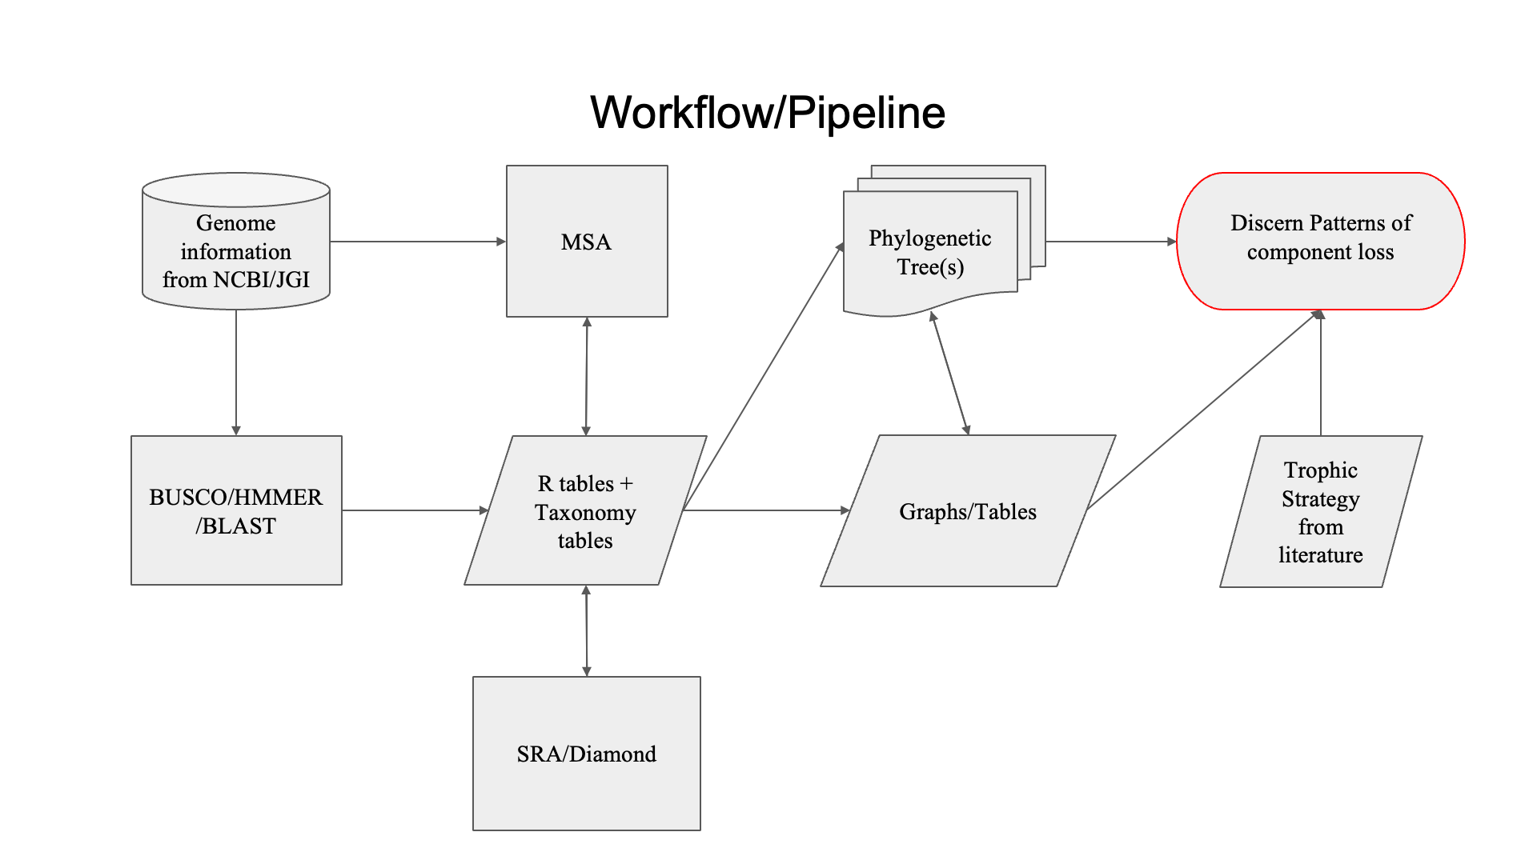


Figure 1

Slide 2
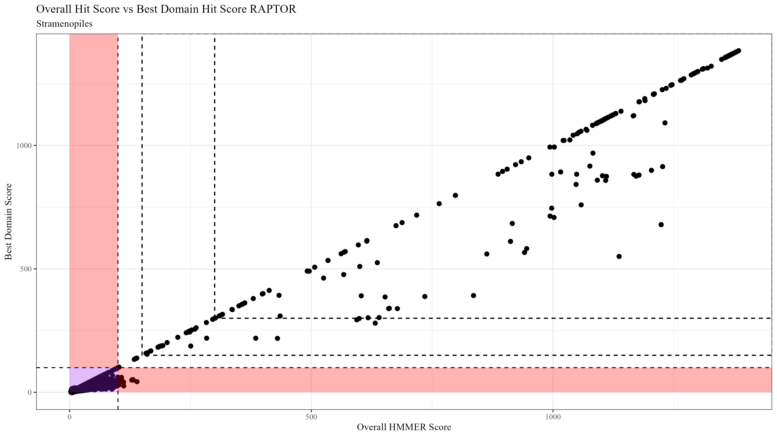
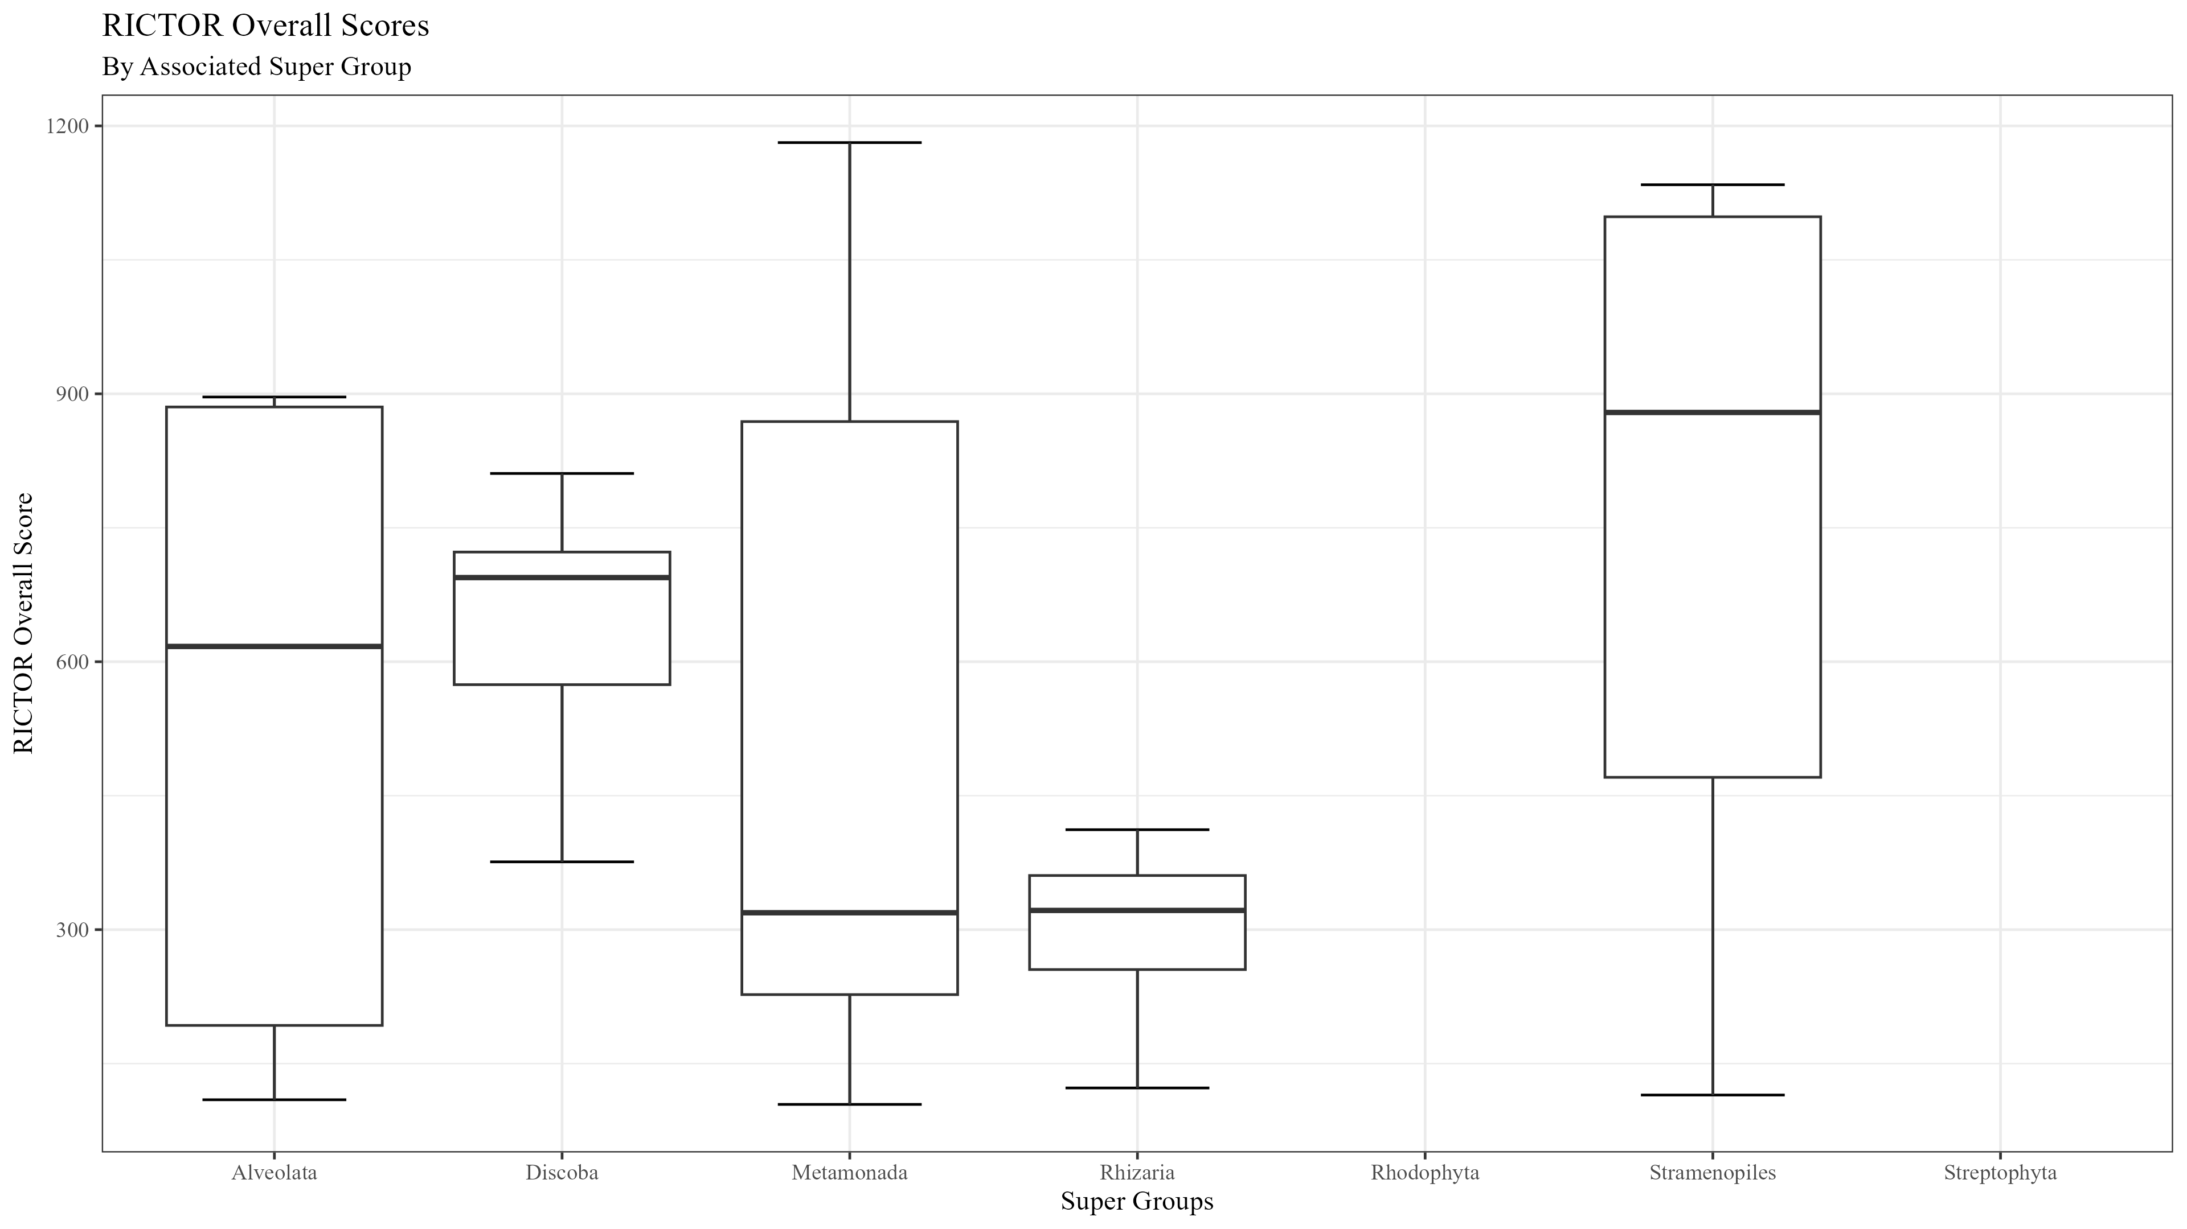
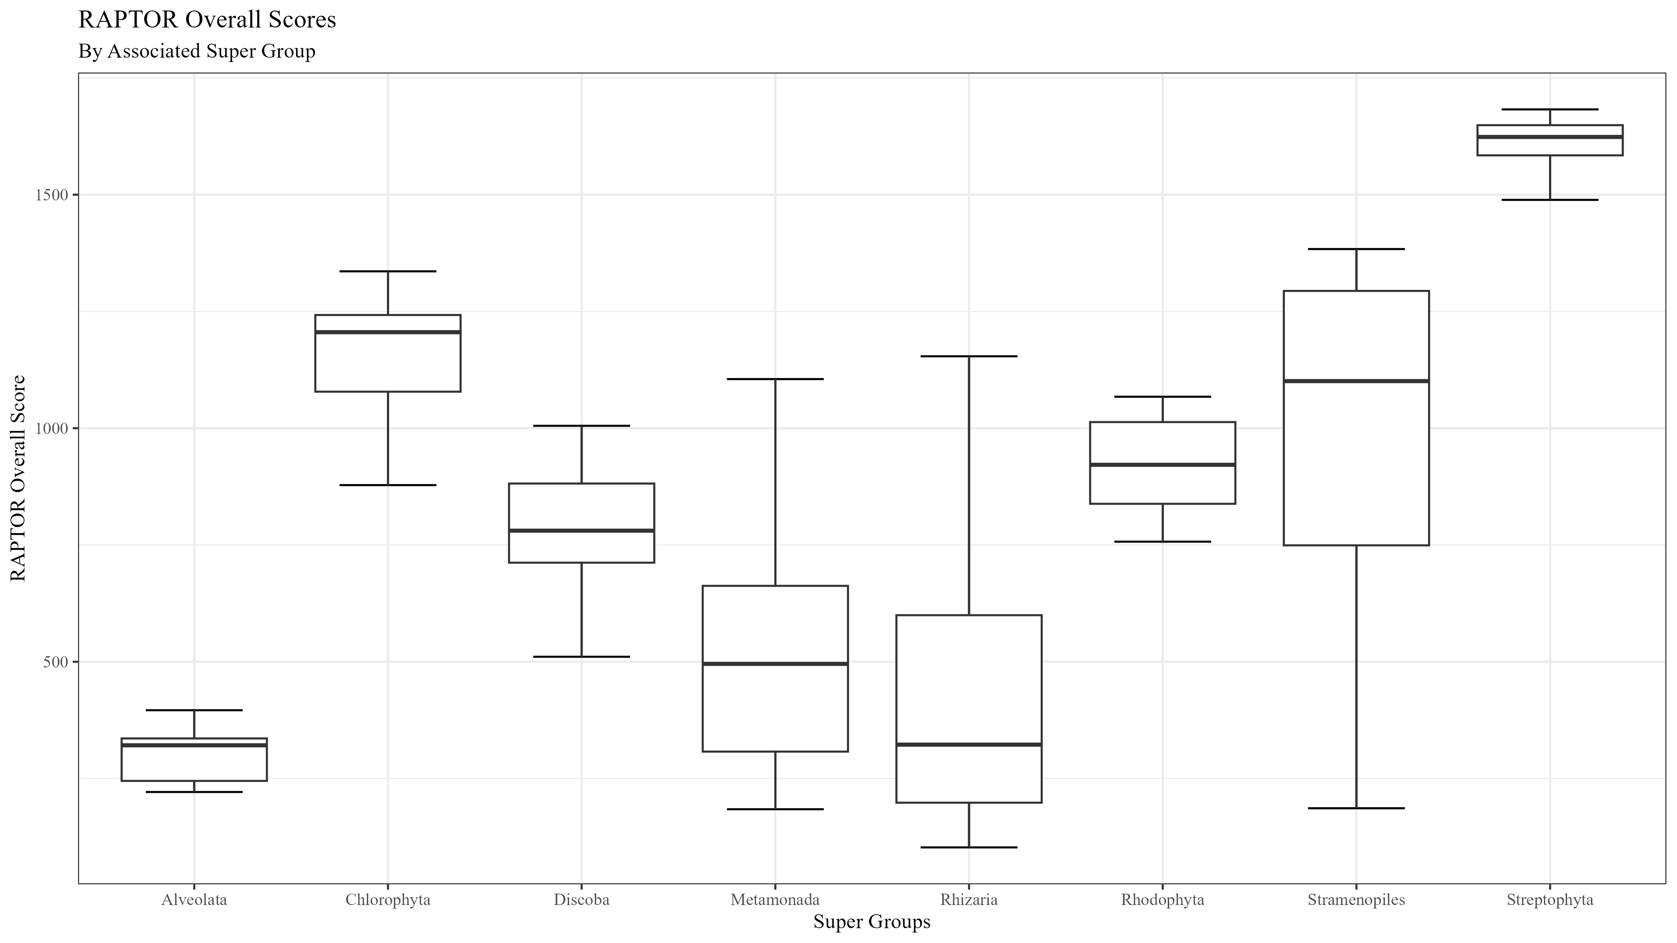
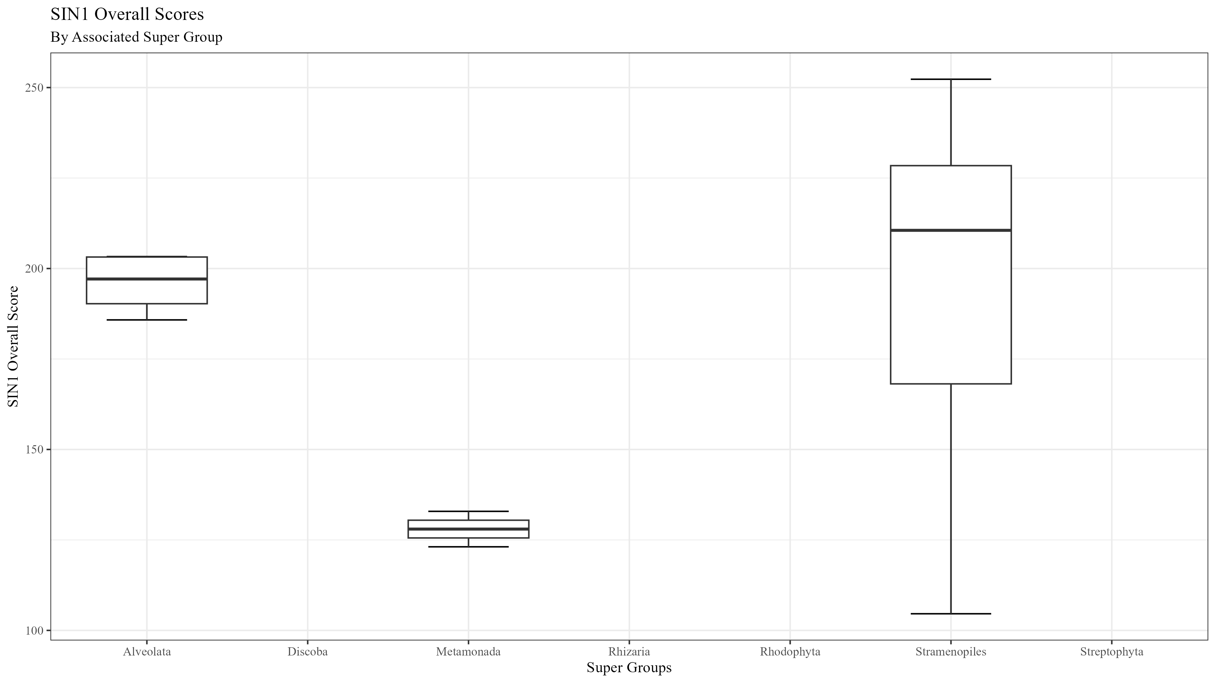
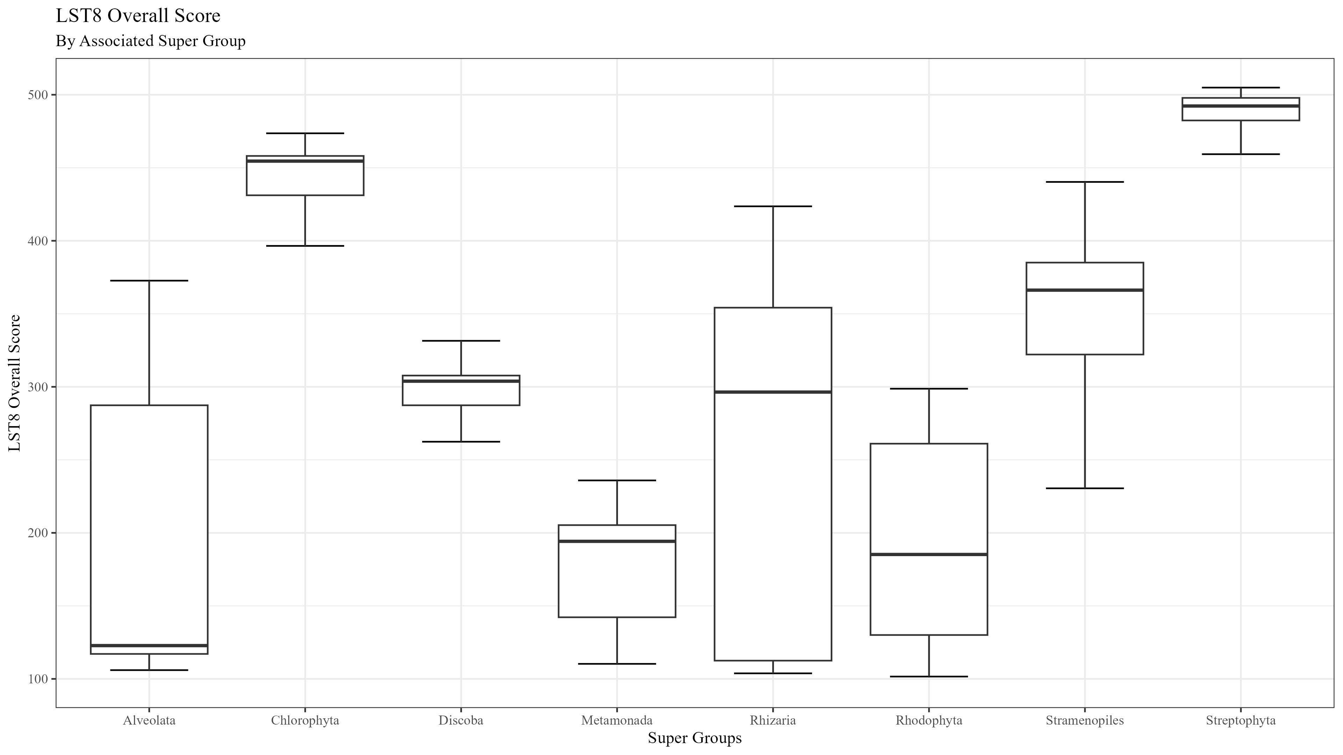

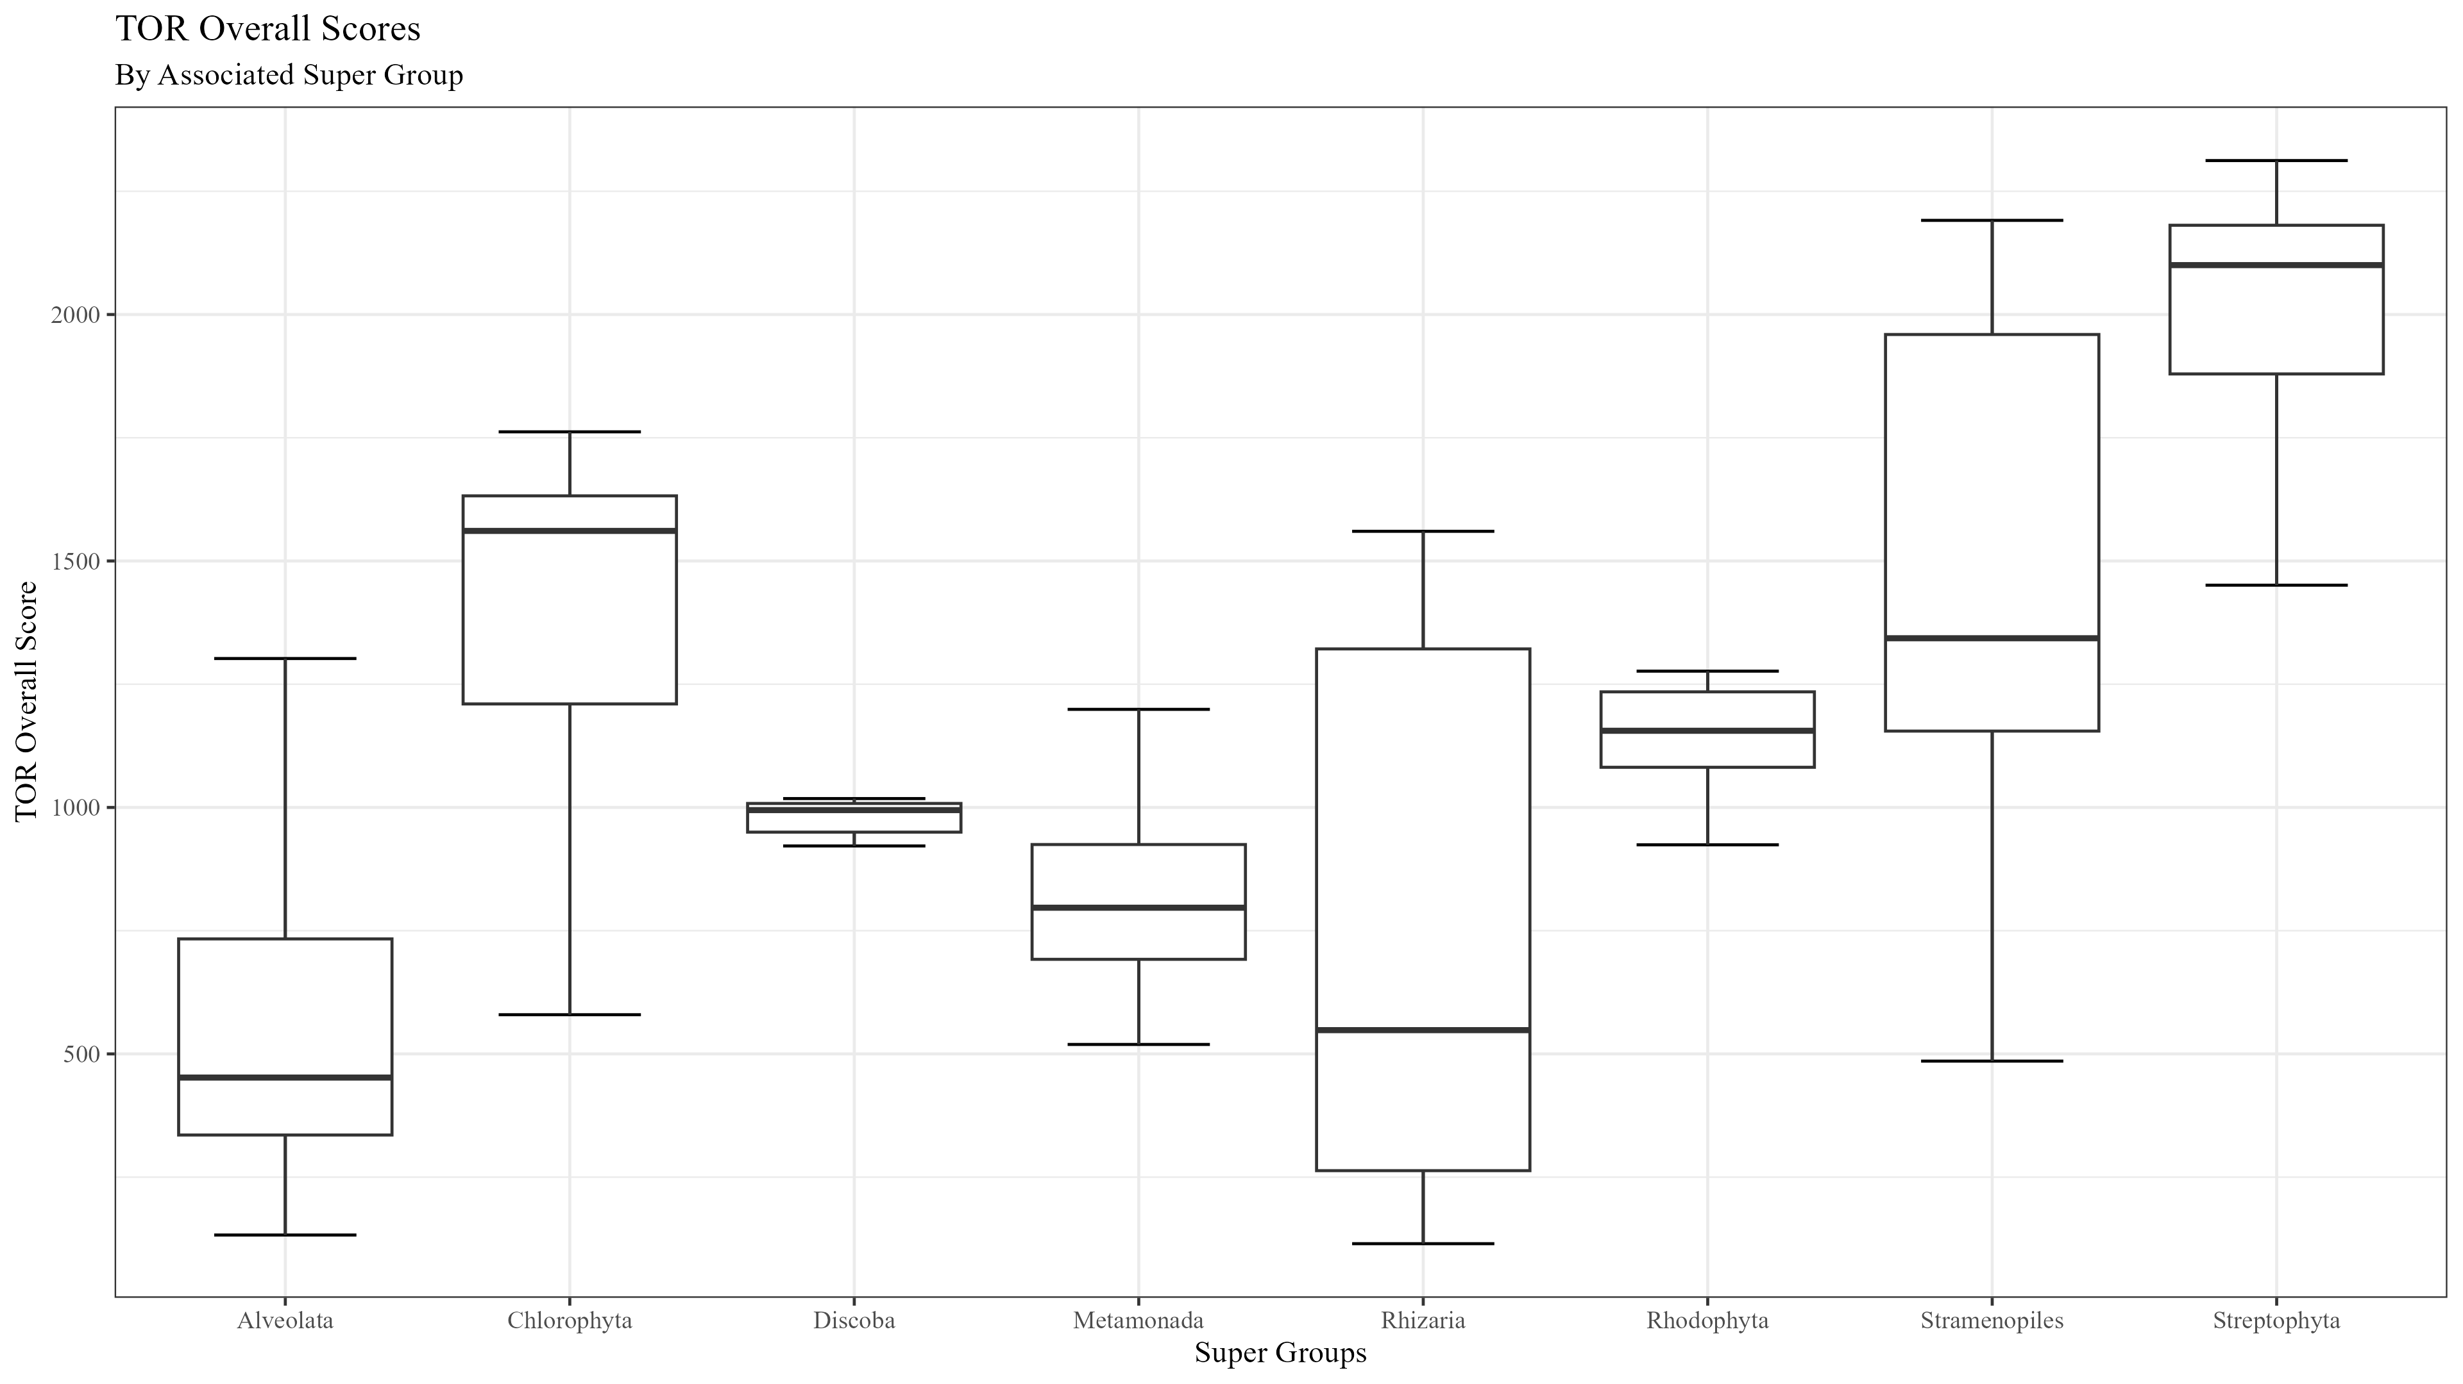
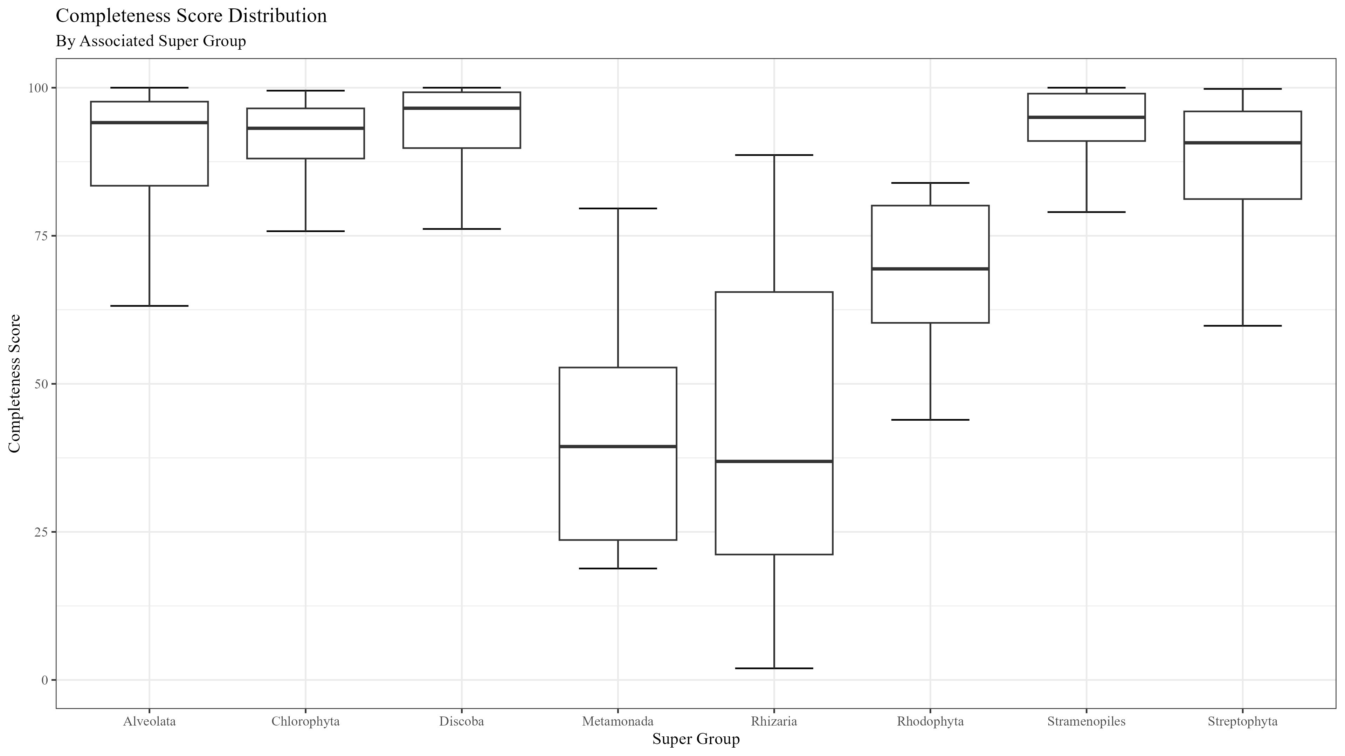
Figure 2

Slide 3










Figure 3
1
1694
RICTORN
RICTORM
RasGEF
Domain5
RICTOR Phosphorylation
ARM Repeats
Reference
High
Medium
Low
1
1353
RAPTORN
ARM Repeats
HEAT
ARM Repeats
WD-40 Repeats
Reference
High
Medium

Slide 4
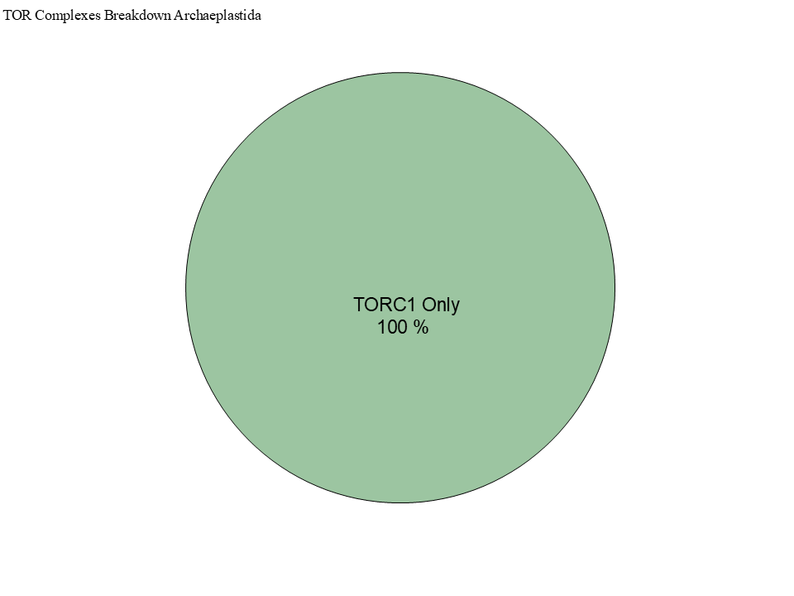
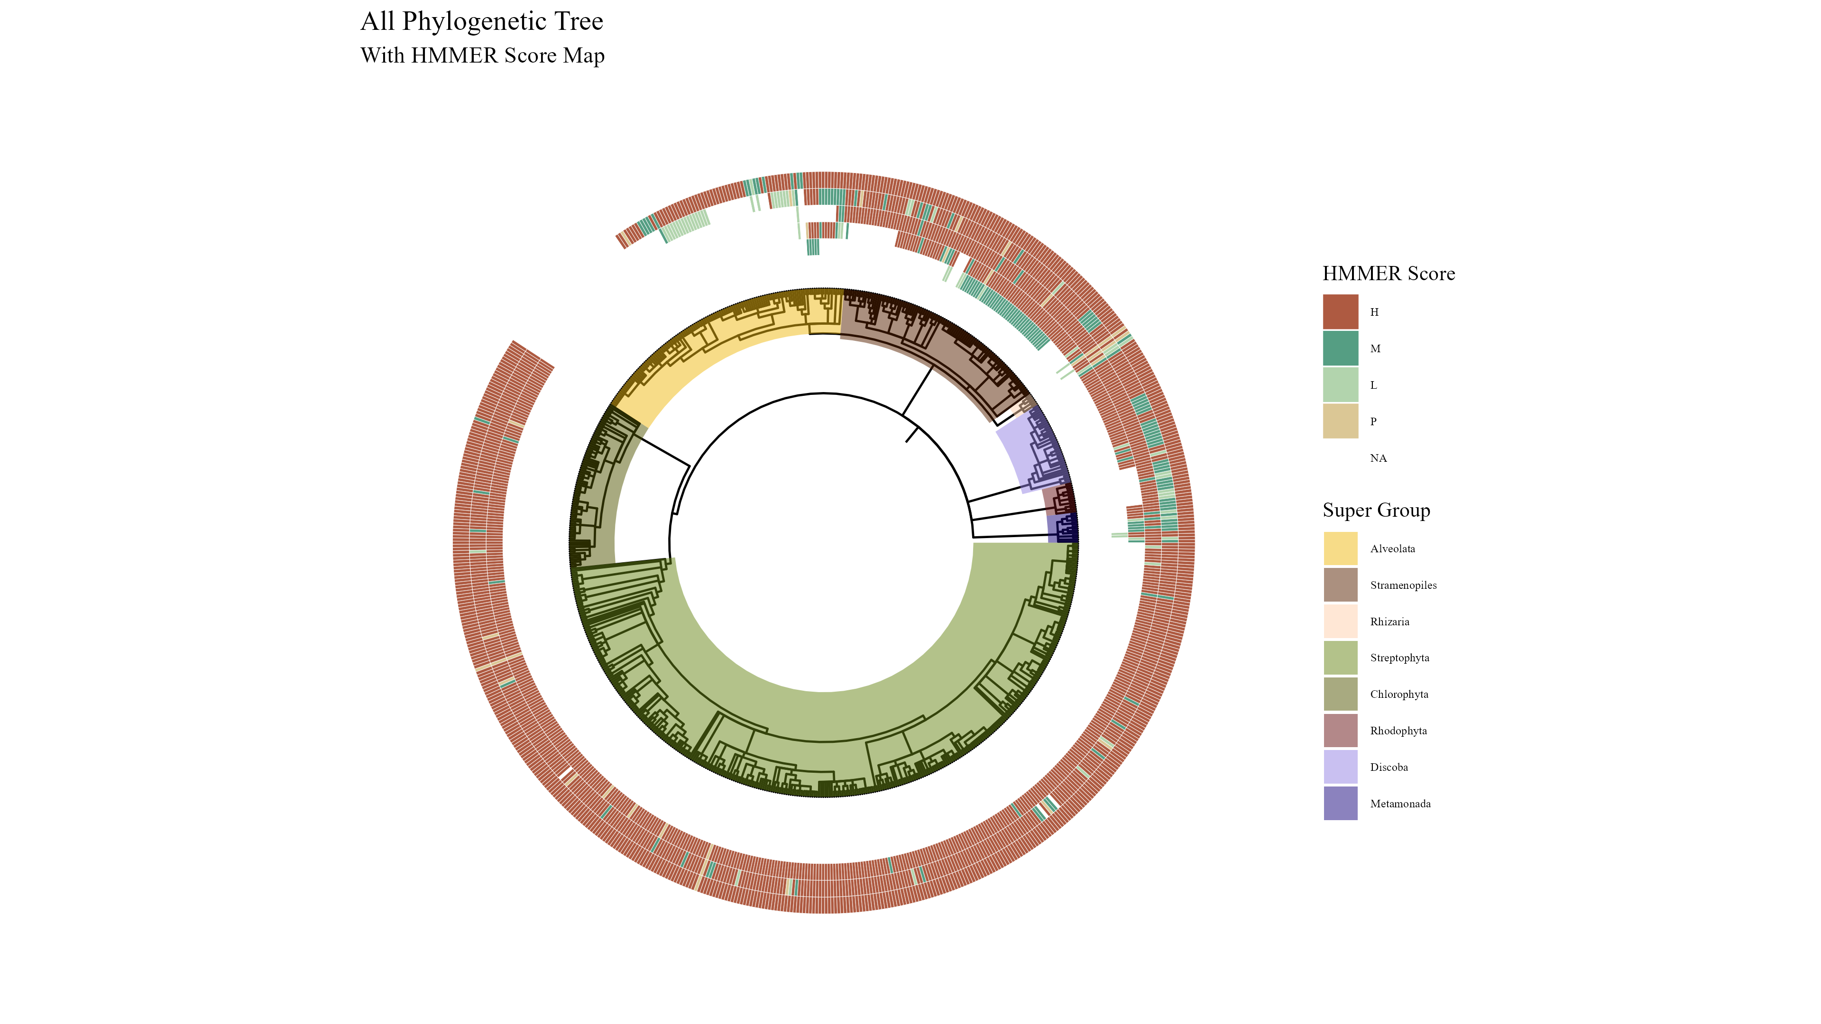
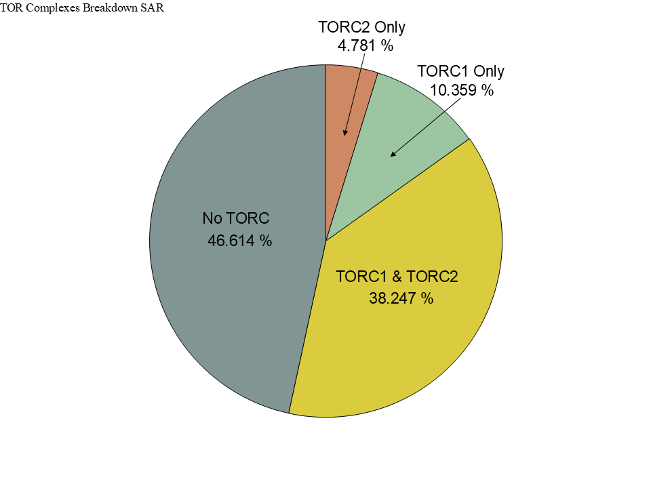
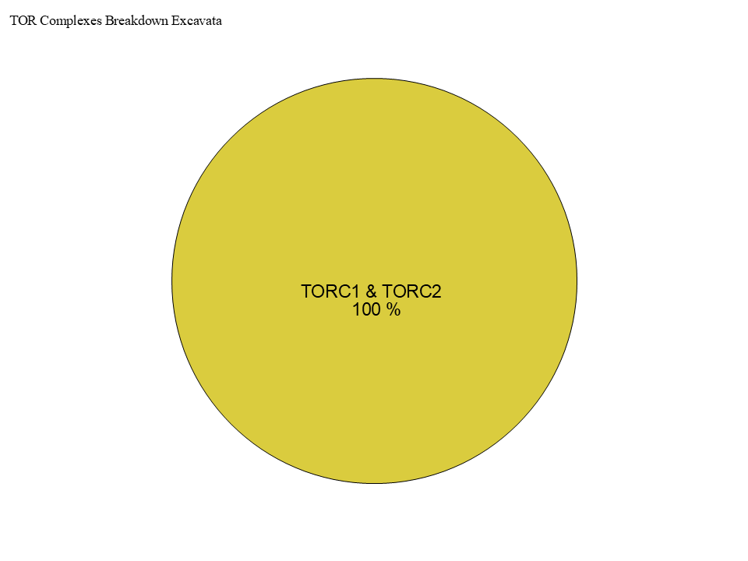
Figure 3
TOR
LST8
RAPTOR
RICTOR
SIN1

Slide 5
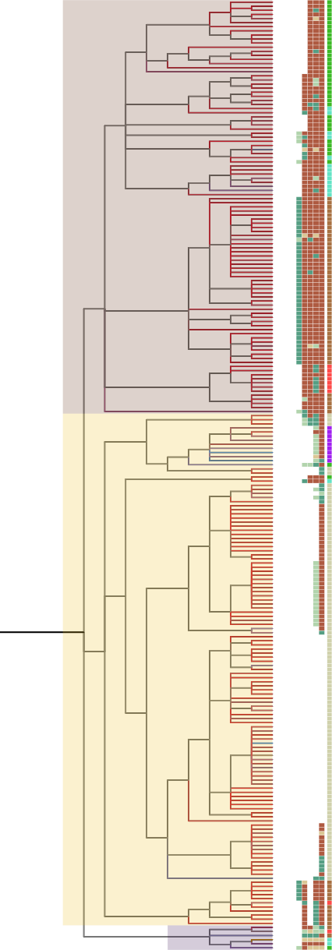
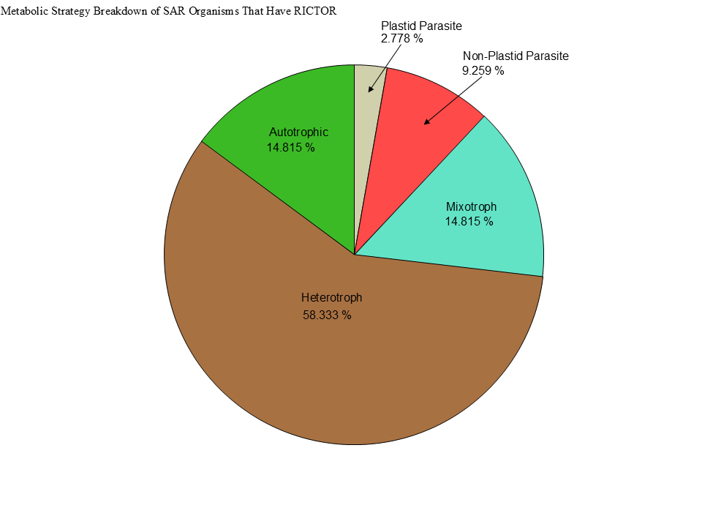
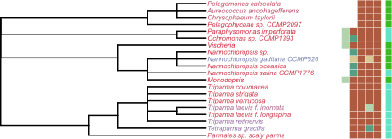
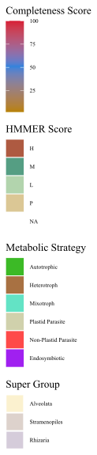
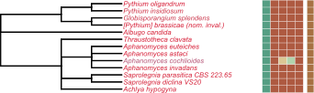
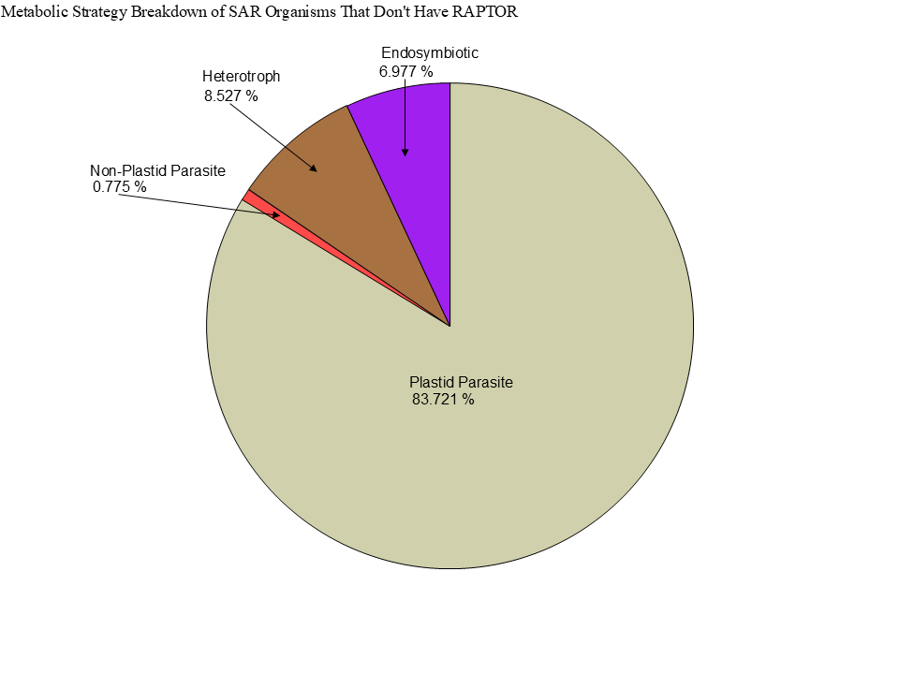
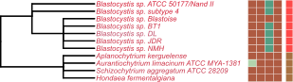
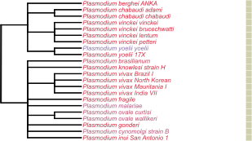
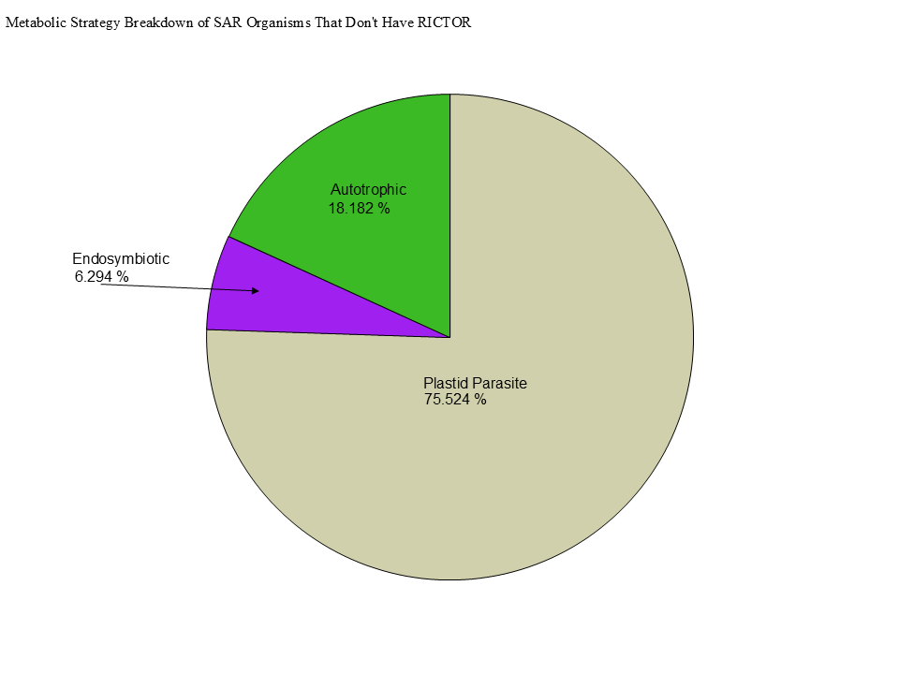
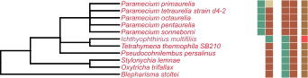
Metabolic Strategy
LST8
RICTOR
RAPTOR
SIN1
TOR
Stramenopiles
Alveolata
Rhizaria

Slide 6
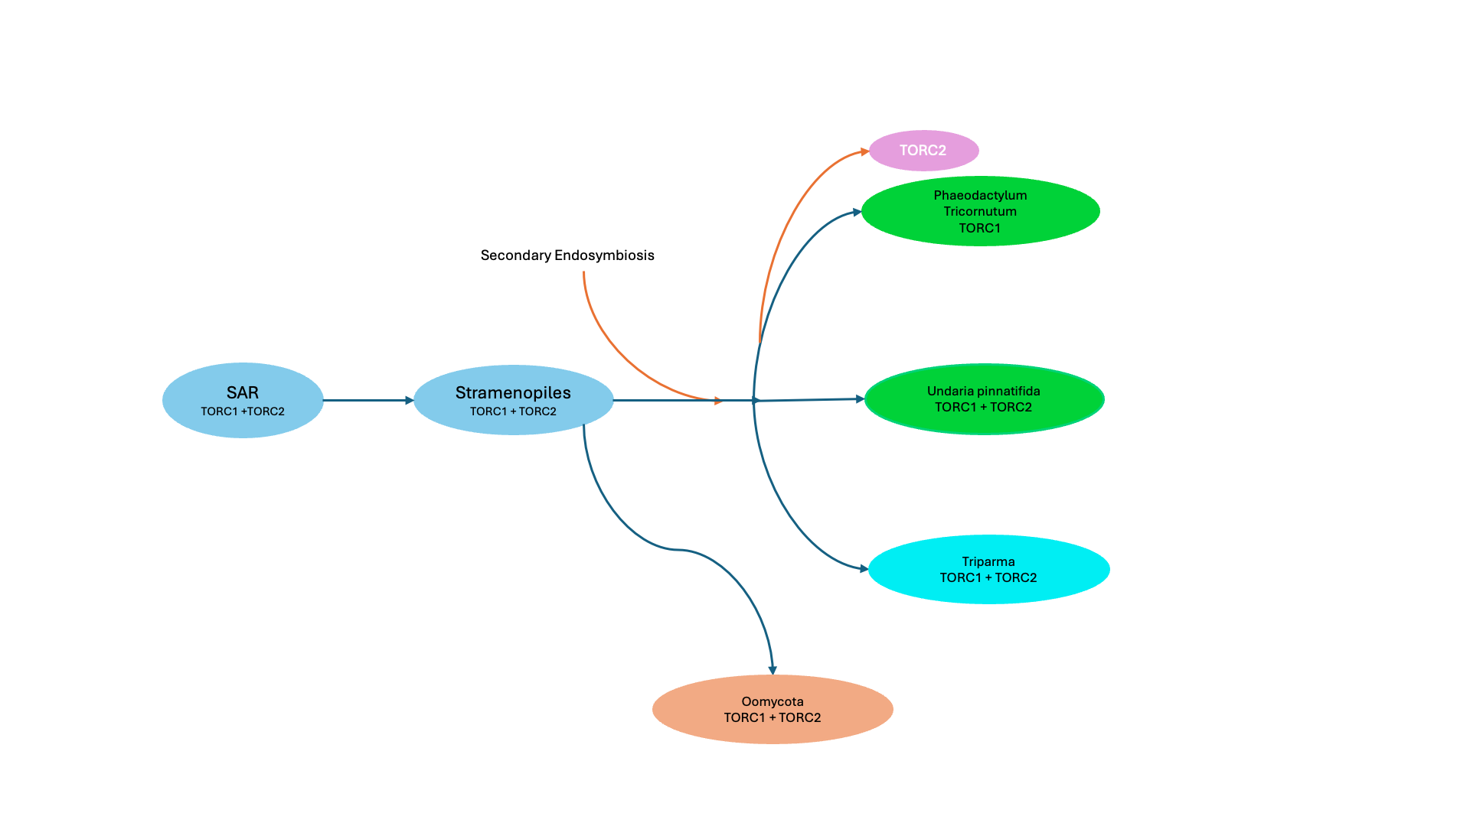

Slide 7
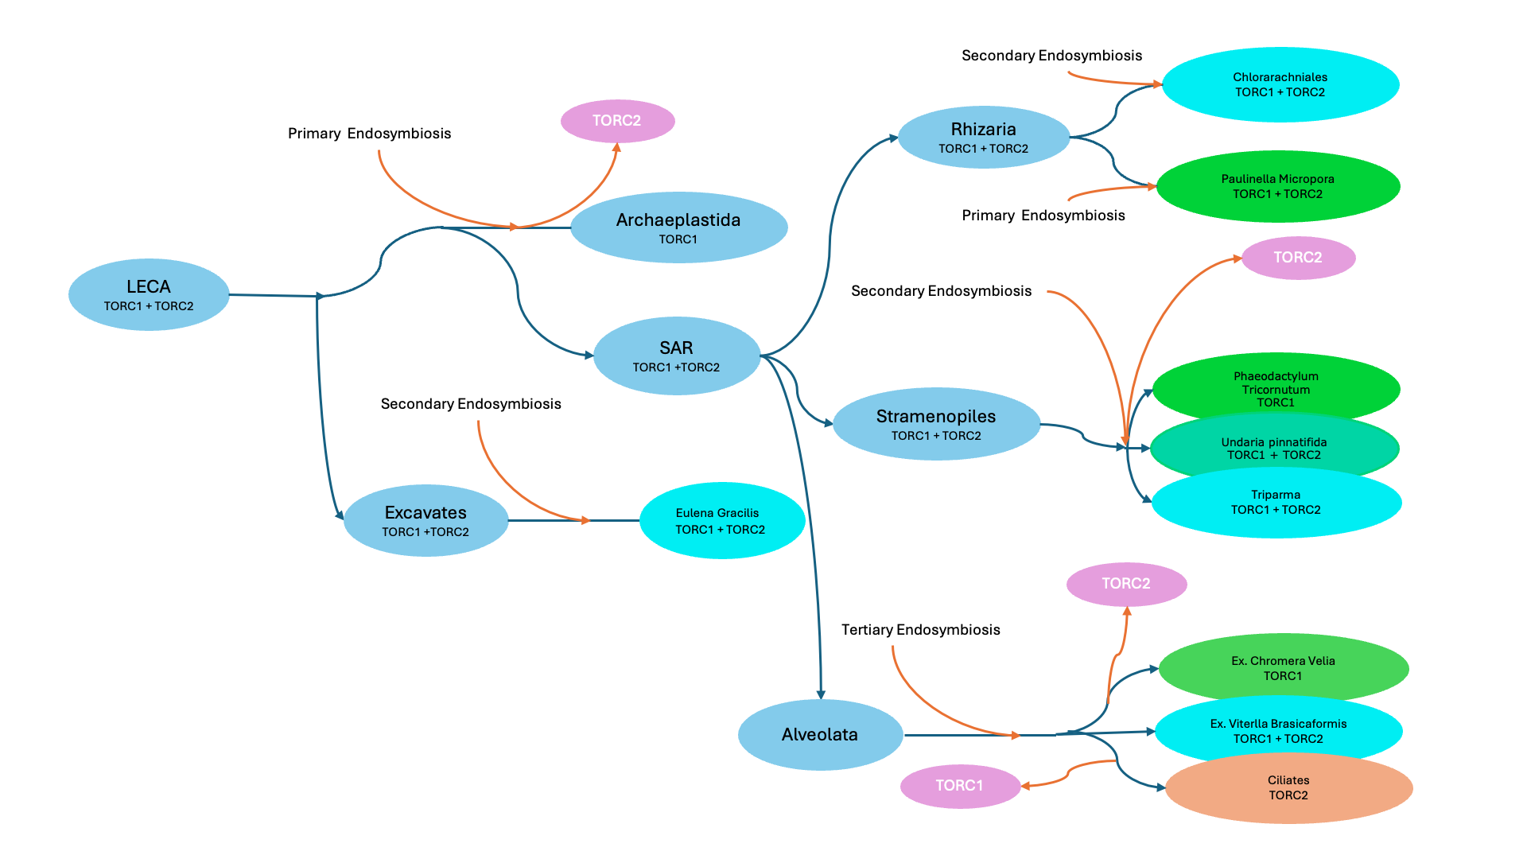

Slide 8
Streptophyta
Secondary Endosymbiosis
Rhodophyta
Primary Endosymbiosis
TORC2
Chlorophyta
Chlorarachniales
TORC1 + TORC2
Rhizaria
TORC1 + TORC2
Primary Endosymbiosis
Archaeplastida
TORC1
LECA
TORC1 + TORC2
Paulinella Micropora
TORC1 + TORC2
SAR
TORC1 +TORC2
Secondary Endosymbiosis
TORC2
Stramenopiles TORC1 + TORC2
Brown Algae
TORC1
Secondary Endosymbiosis
Excavates
TORC1 +TORC2
Tertiary Endosymbiosis
TORC2 + TORC1
Eulena Gracilis
TORC1 + TORC2
Alveolata

Slide 9




Figure 5

Slide 10
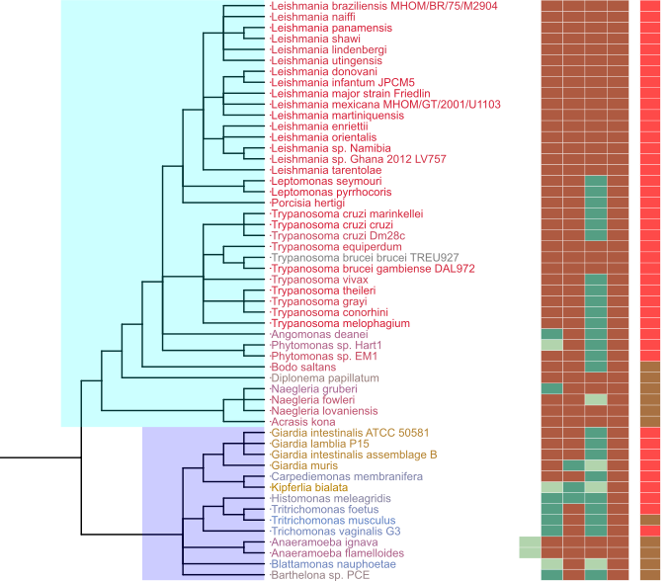
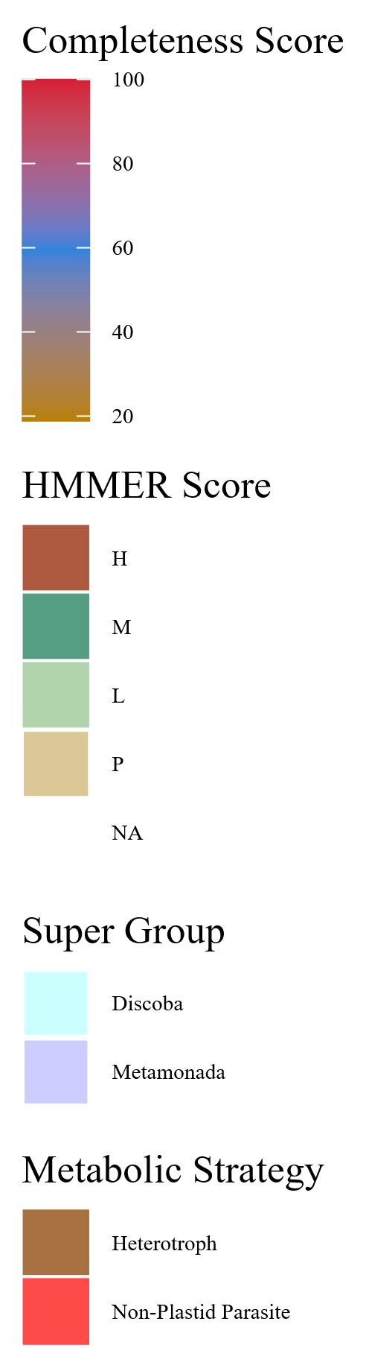
Figure 7
Metabolic Strategy
SIN1
RICTOR
RAPTOR
LST8
TOR
Discoba
Metamonada

Slide 11
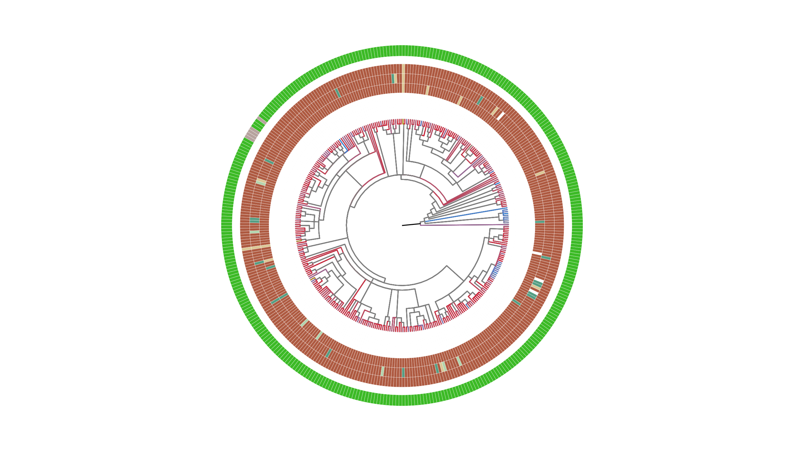
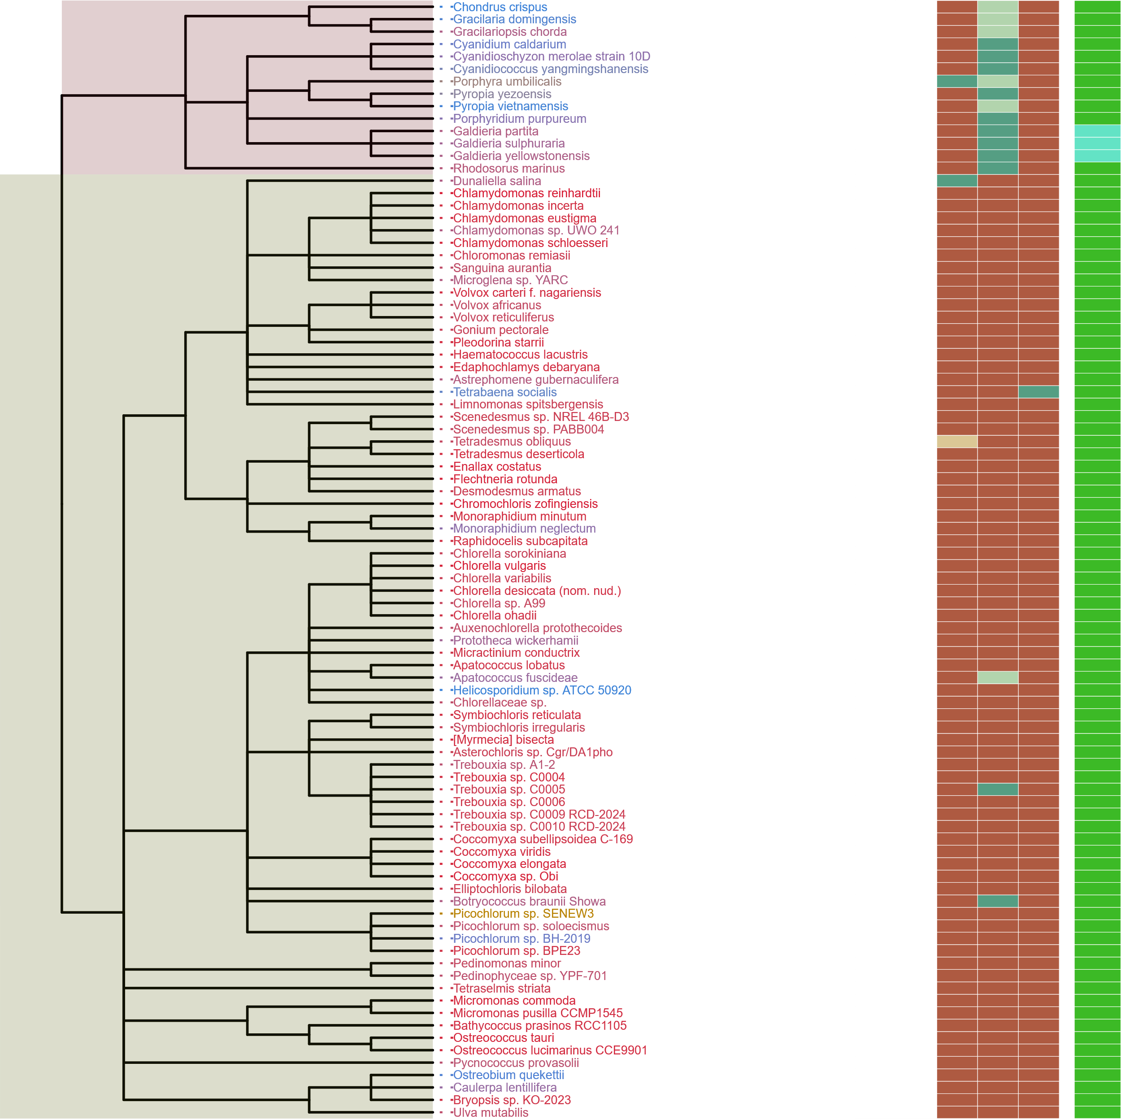
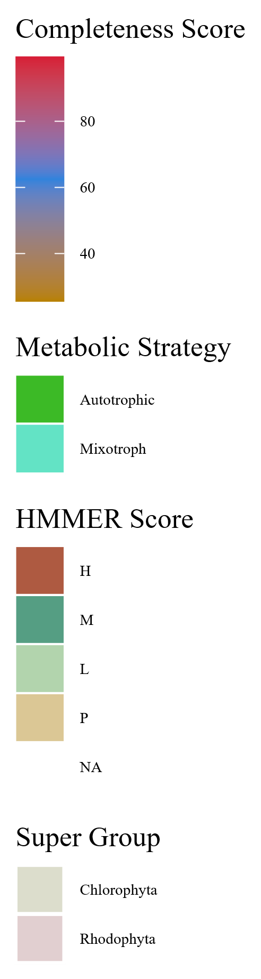
Metabolic Strategy
SIN1
RICTOR
RAPTOR
LST8
TOR
Streptophyta
Rhodophyta
Chlorophyta

Slide 12
ARCHIVED BELOW

Slide 13
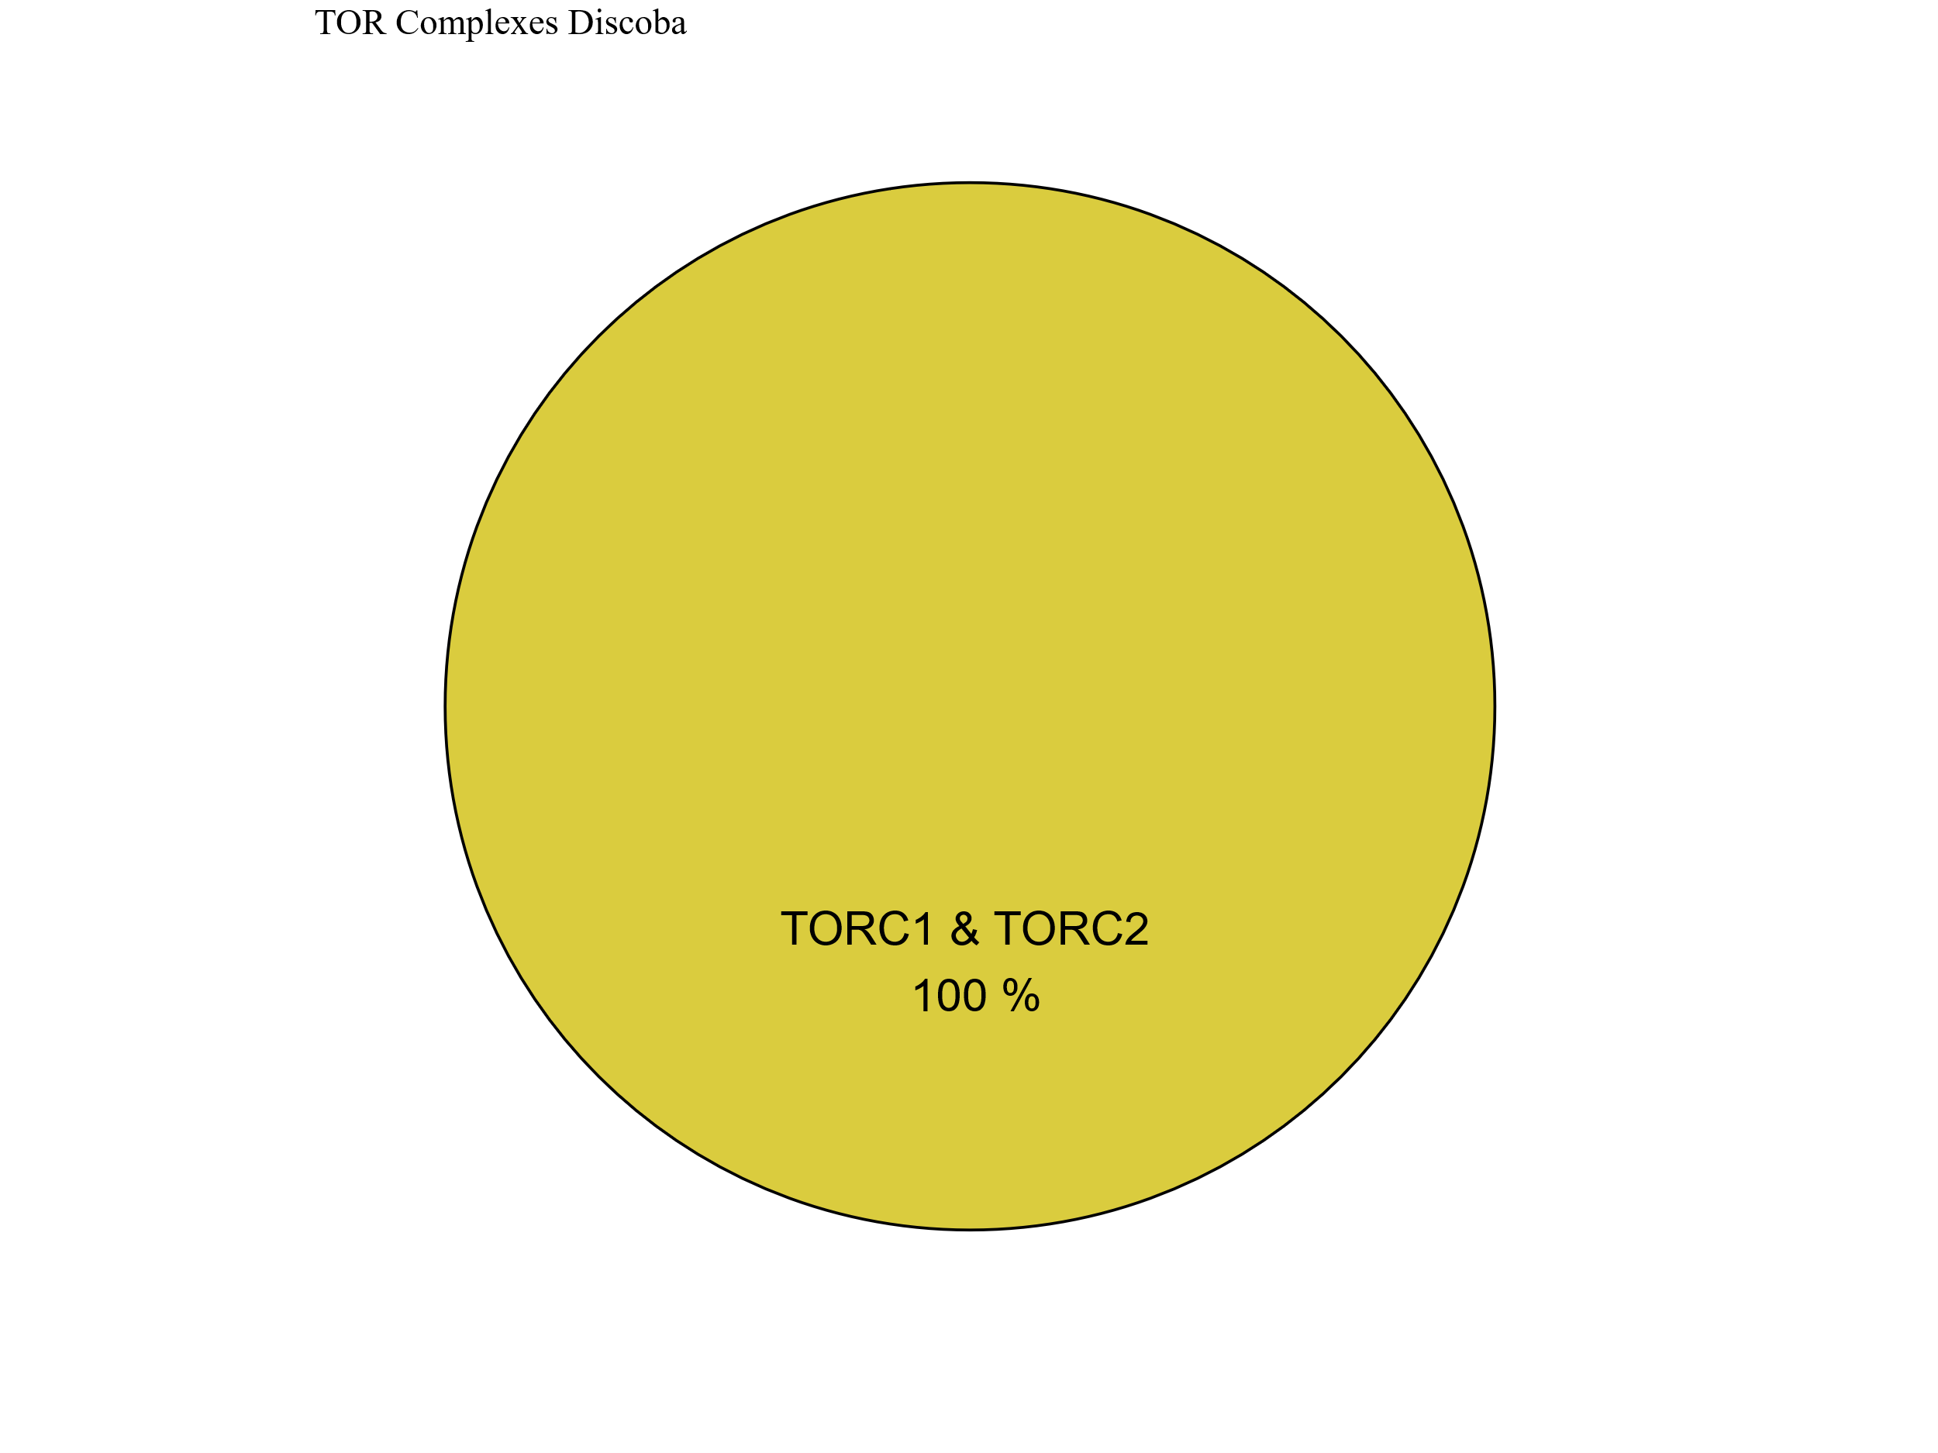
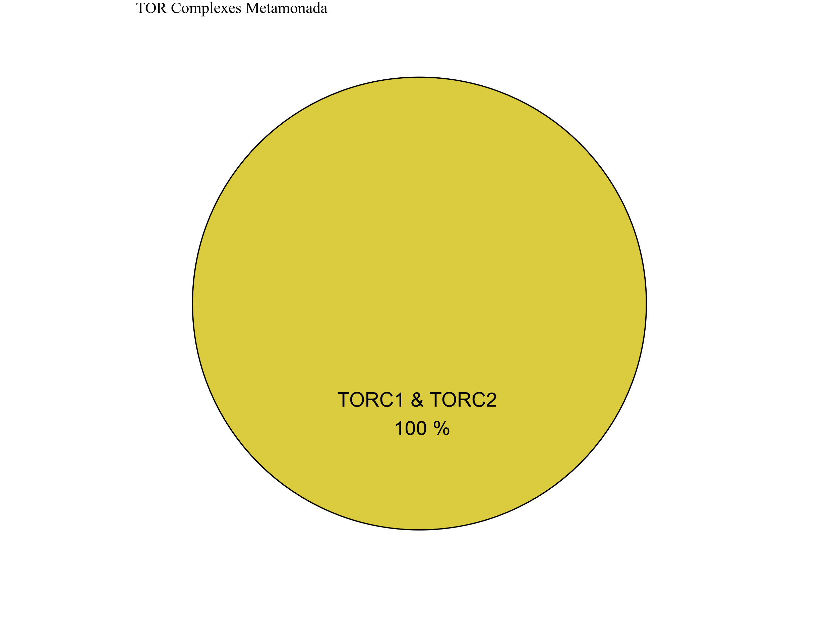
Figure 7
Metabolic Strategy
SIN1
RICTOR
RAPTOR
LST8
TOR
Discoba
Metamonada

Slide 14
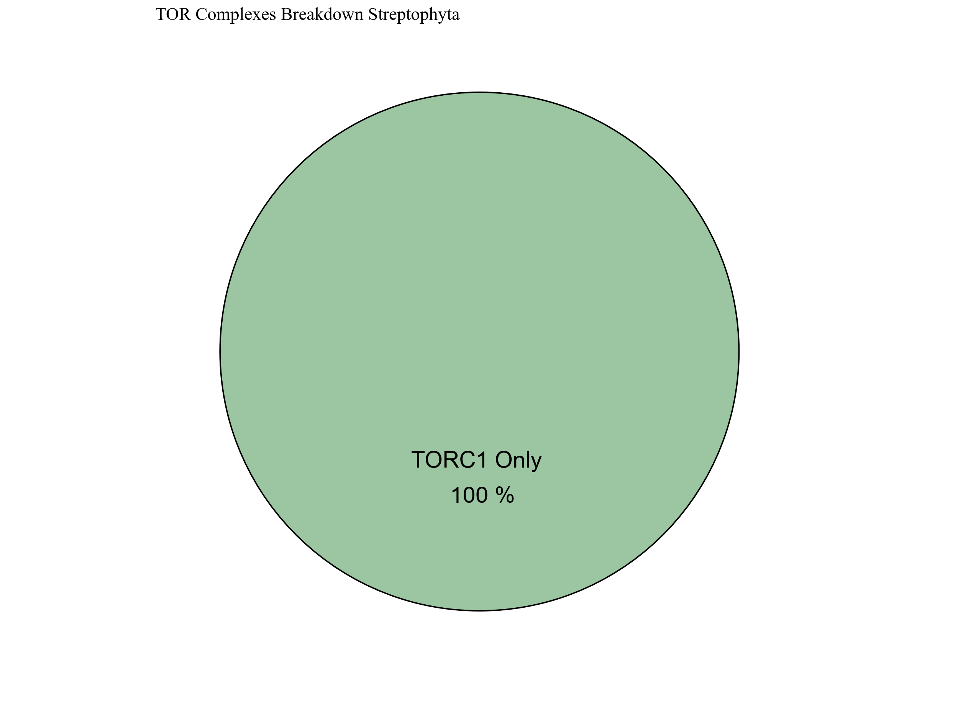
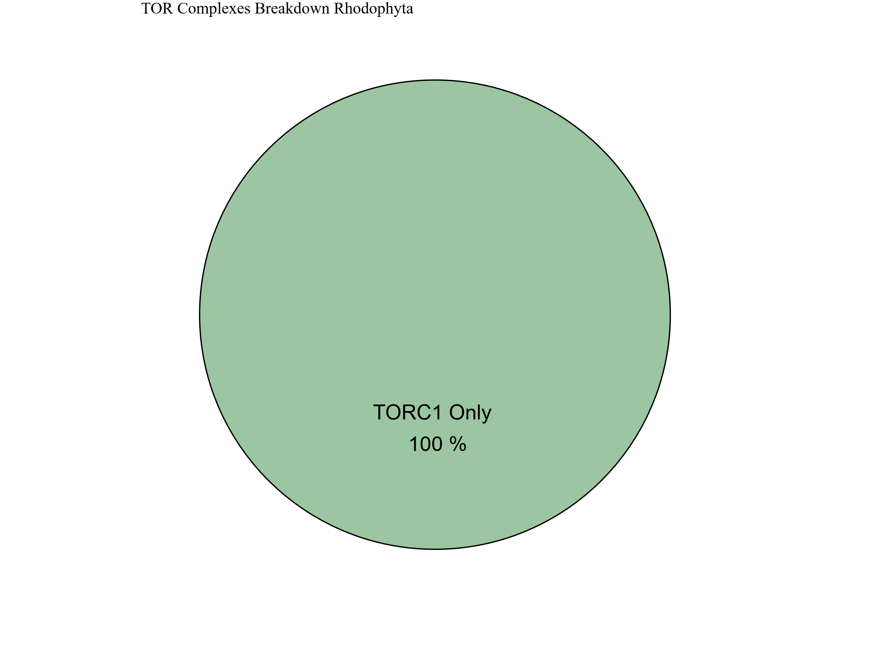
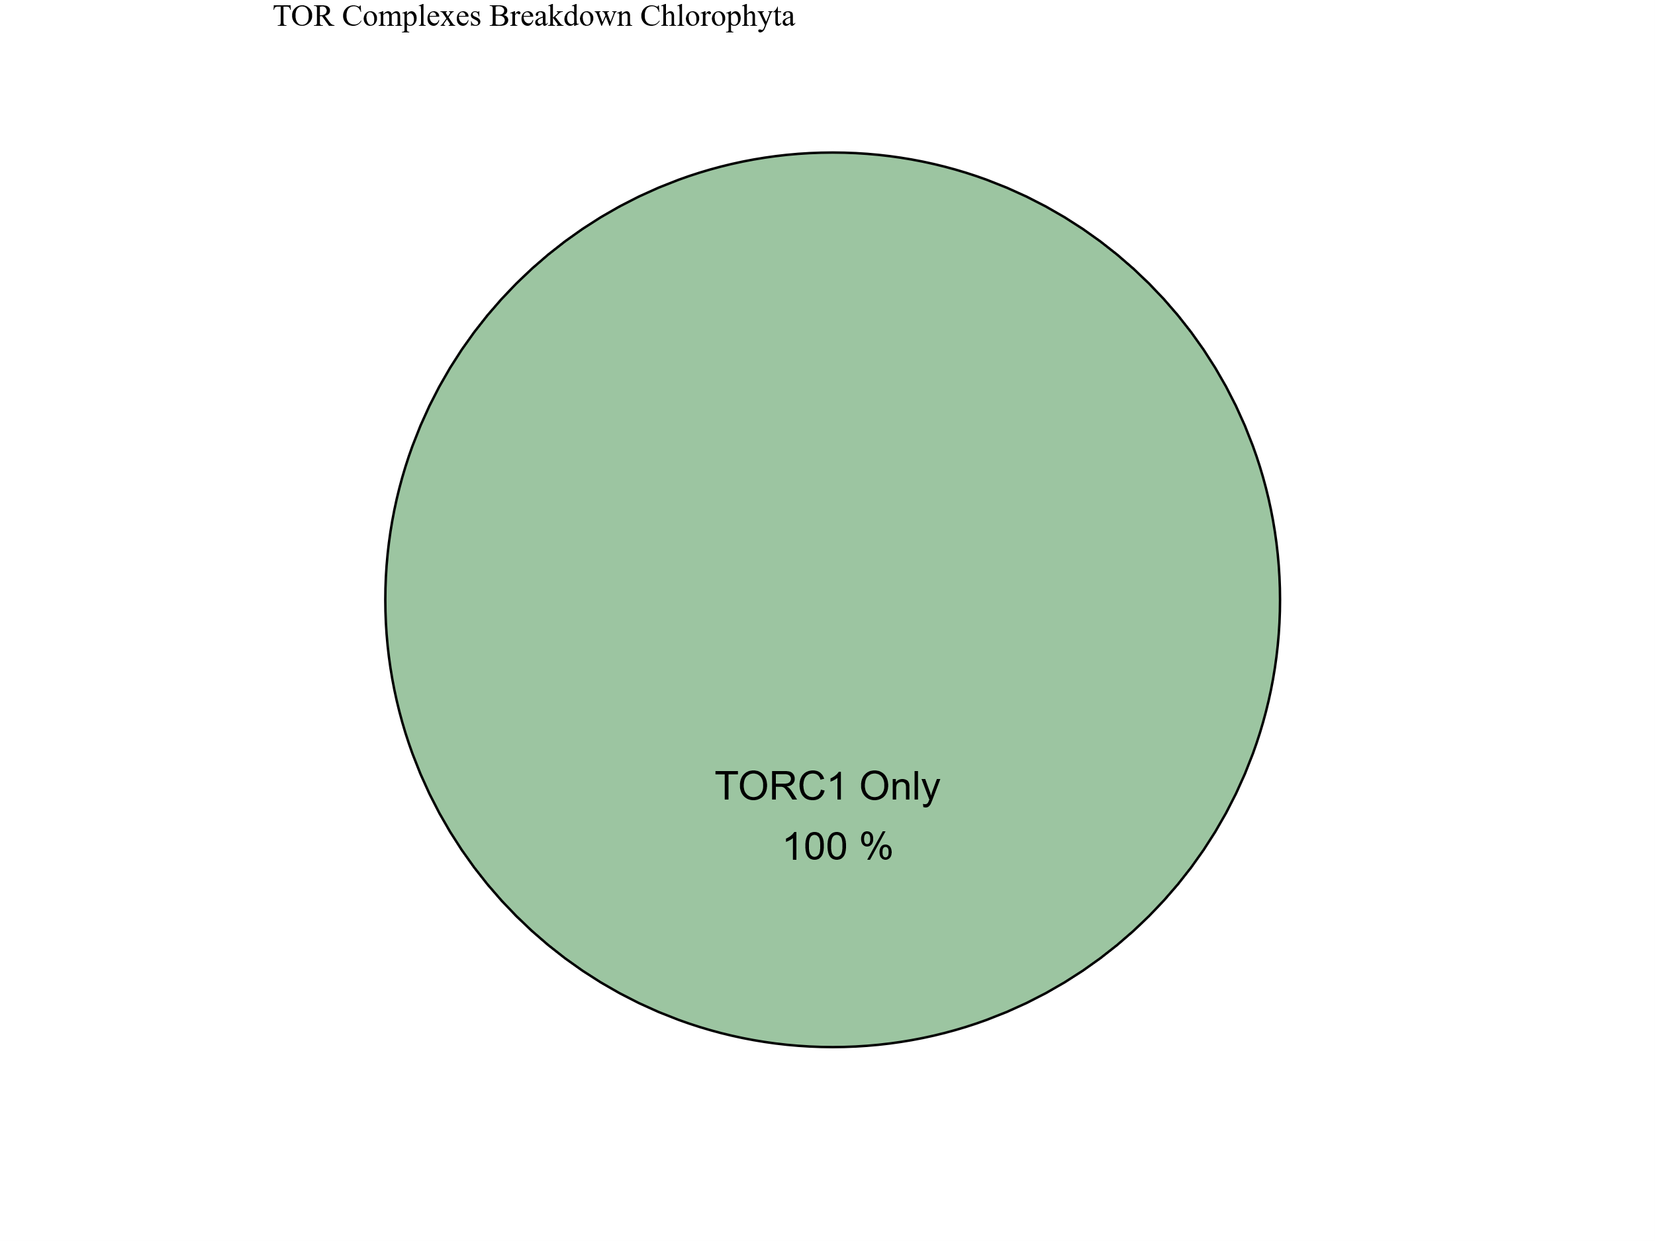
Metabolic Strategy
Streptophyta
SIN1
RICTOR
RAPTOR
LST8
TOR
Rhodophyta
Chlorophyta

Slide 15



Slide 16





Figure 6

Slide 17
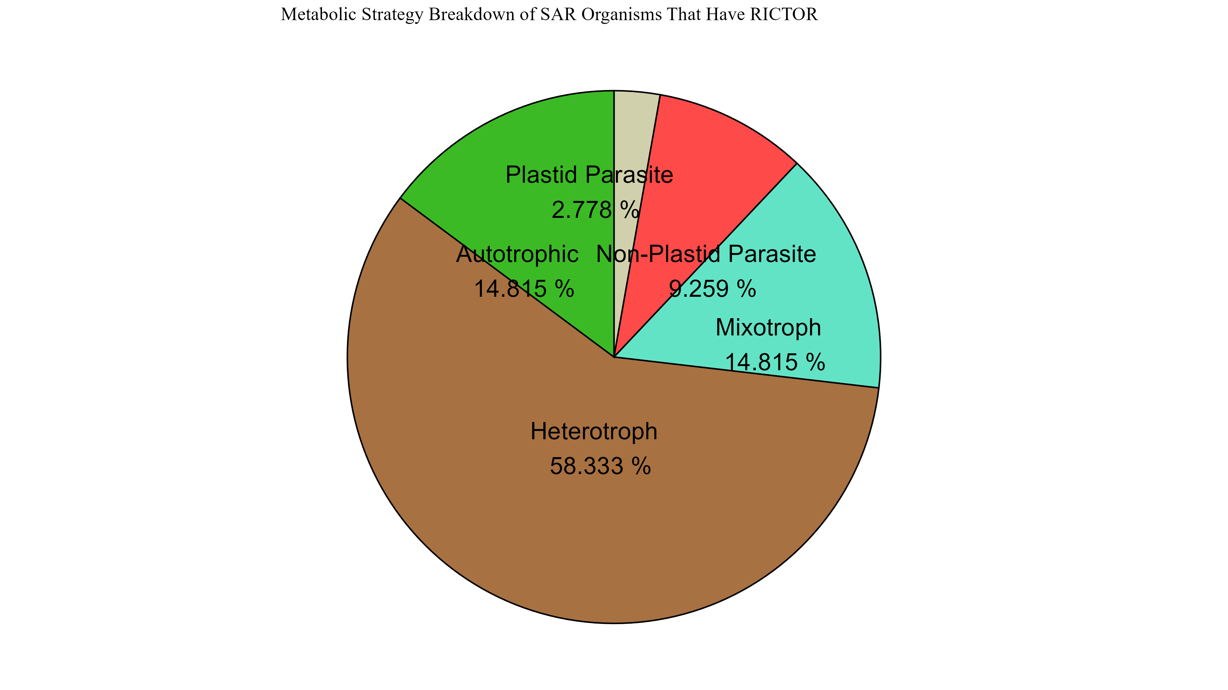
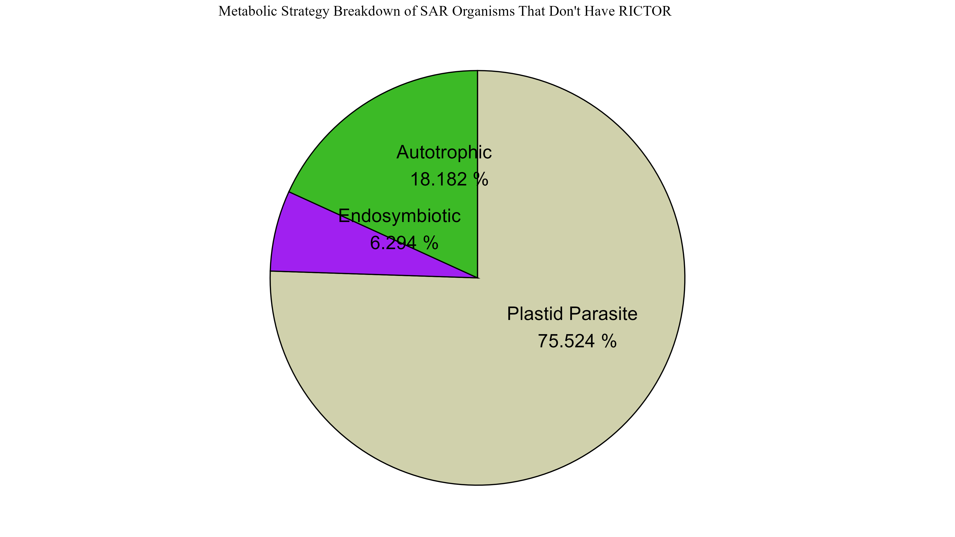
Figure 6

Slide 18
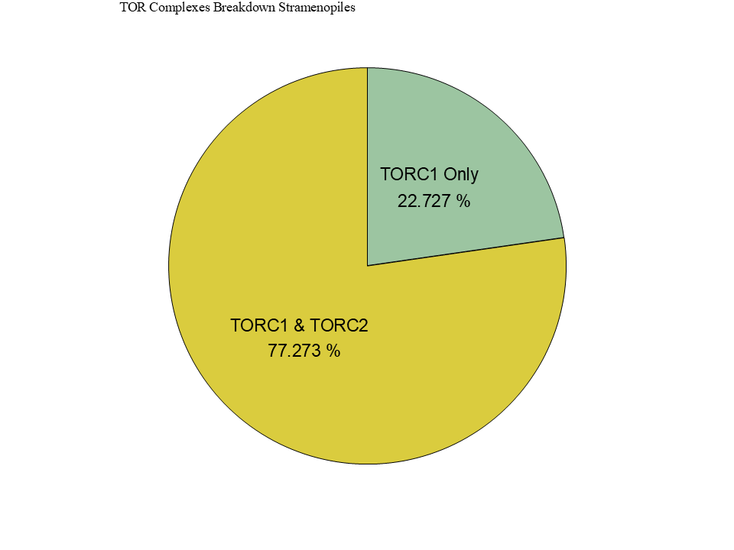
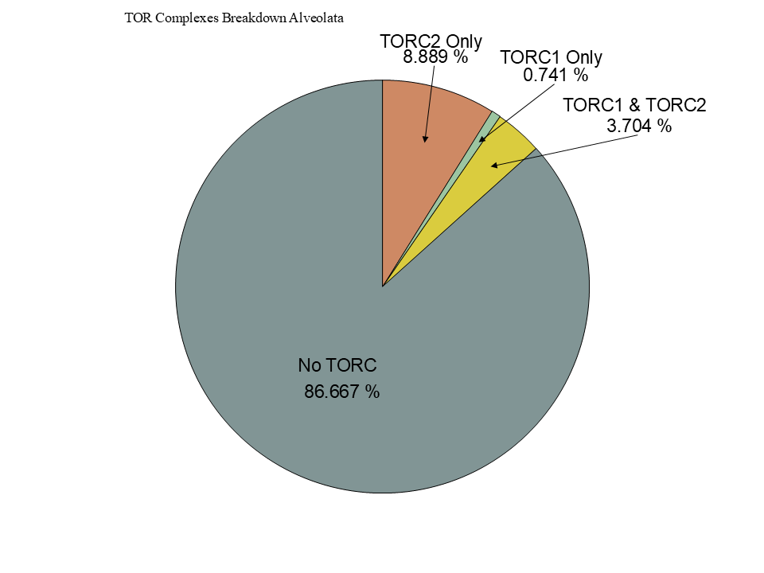
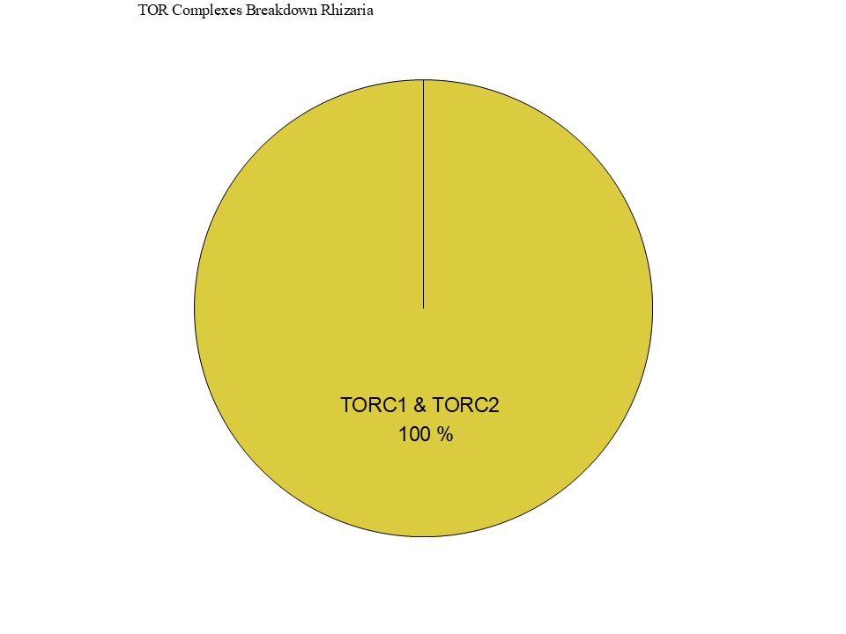
Figure 6

Slide 19
Figure 5

Slide 20
Workflow/Pipeline
NCBI/JGI Genomic Information
MSA
Phylogenetic Tree(s)
Results/TOR Complex Patterns
BUSCO/HMMER/BLAST
R Tables & Taxonomy Tables
Graphs/Data Table
SRA /Diamond Alignment
Notes:
We need to add a start point. Have something that asks the question; what organisms have TORC2 Components and TORC1 Components?

Slide 21
SARs Gain of Plastids:
Losses of TOR Complexes
Rhodophyta Endosymbiosis
Phaeodactylum tricornutum
TORC2 Lost
Macrocystis pyrifera
Stramenopila
Nannochloropsis gaditana
Phytophthora sojae
Expected Heterotrophic Ancestor
TORC1 & TORC2 Present
Stramenopile Endosymbiosis
Polarella glaciallis
Vitrella Brassicaformis
Alveolata
Plasmodium falciparum
Tetrahymena thermophila
Alpha-Cyanobacteria Endosymbiosis
Photoautorophy Loss
Paulinella micropora
TORC1 and TORC2 Lost
Bigelowiella natans
TORC1 Lost
Rhizaria
Chlorophyta Endosymbiosis
Plasmodiophora brassicae

Slide 22
Figure 4

Slide 23
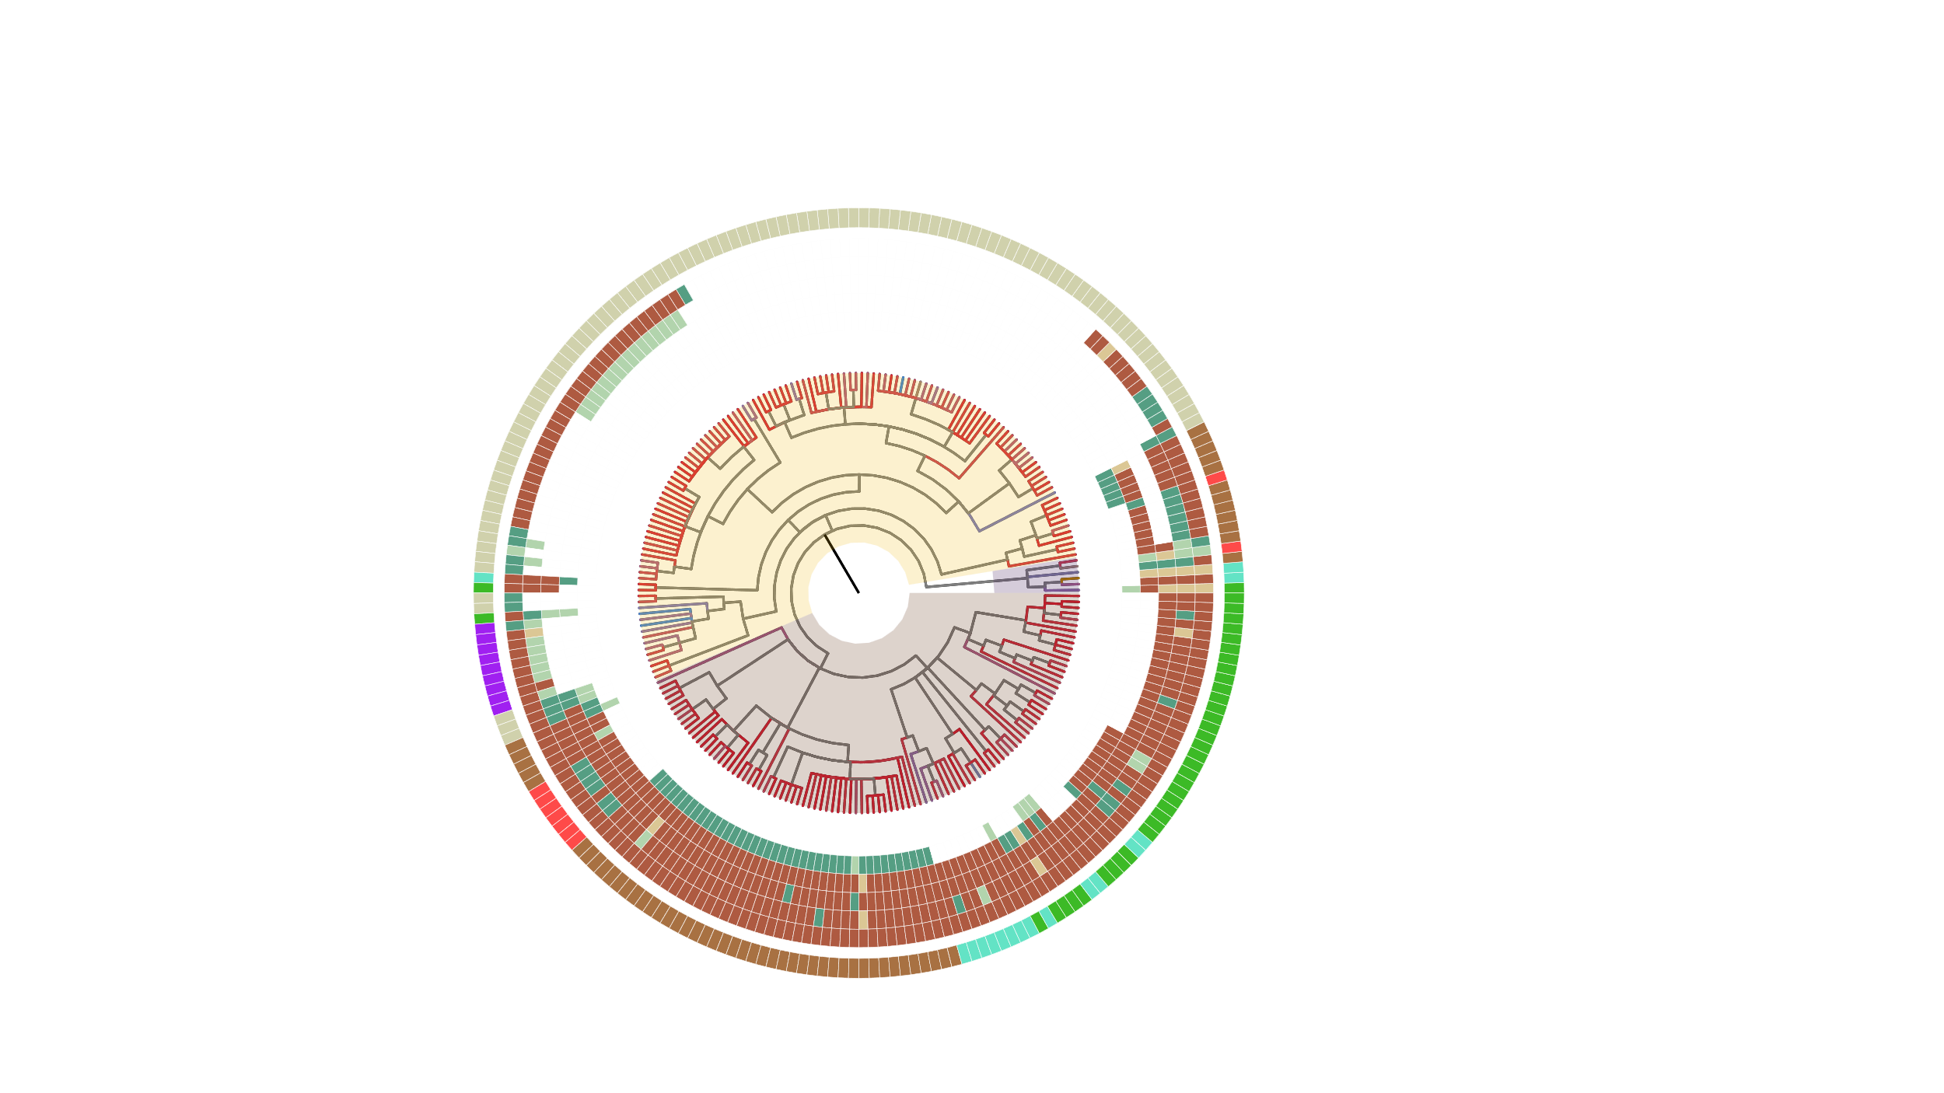

Slide 24
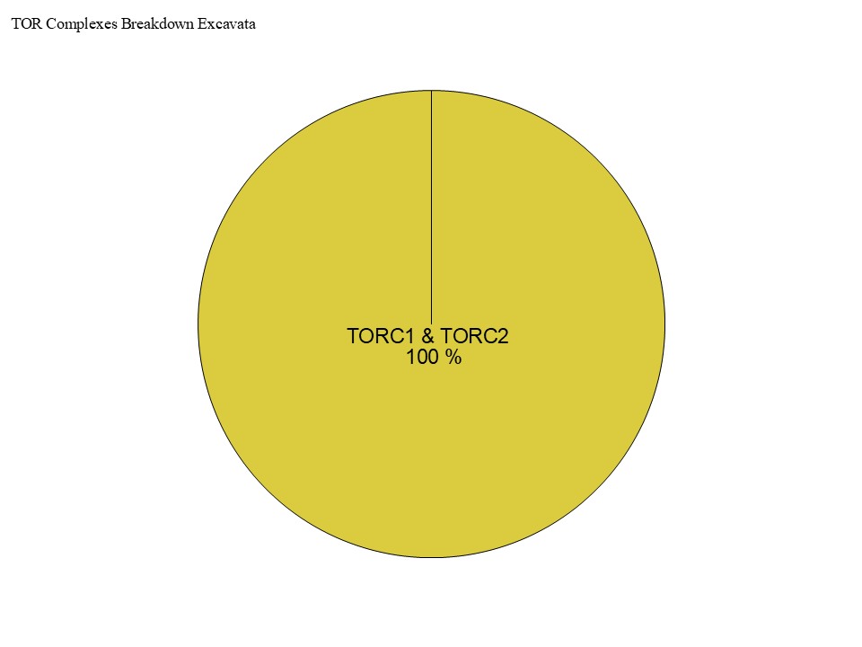
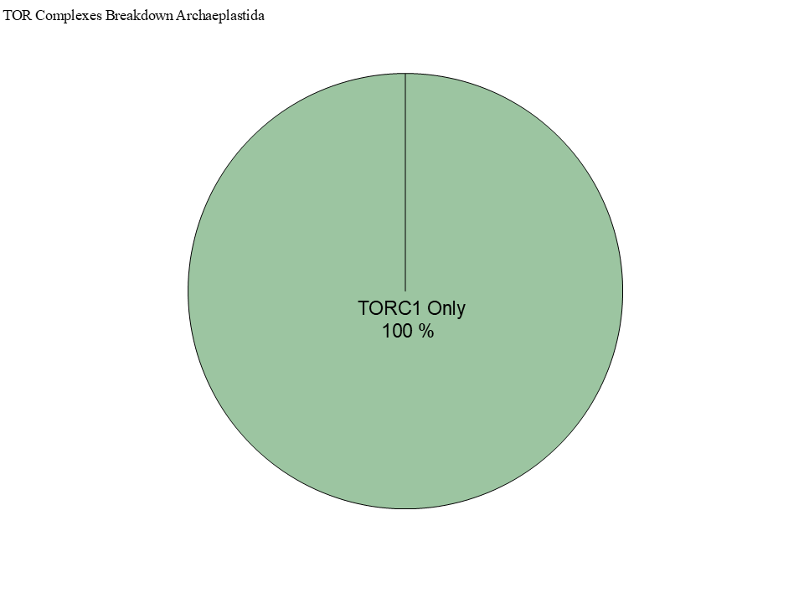
Figure 4

Slide 25
Simplified Excavata Gain of Plastids
Chlorophyta Endosymbiosis
Euglenophyceae
Discoba
Kinetoplastea
Eutetramitia, etc.
Expected Heterotrophic Ancestor
TORC1 & TORC2 Present
Metamonada

Slide 26
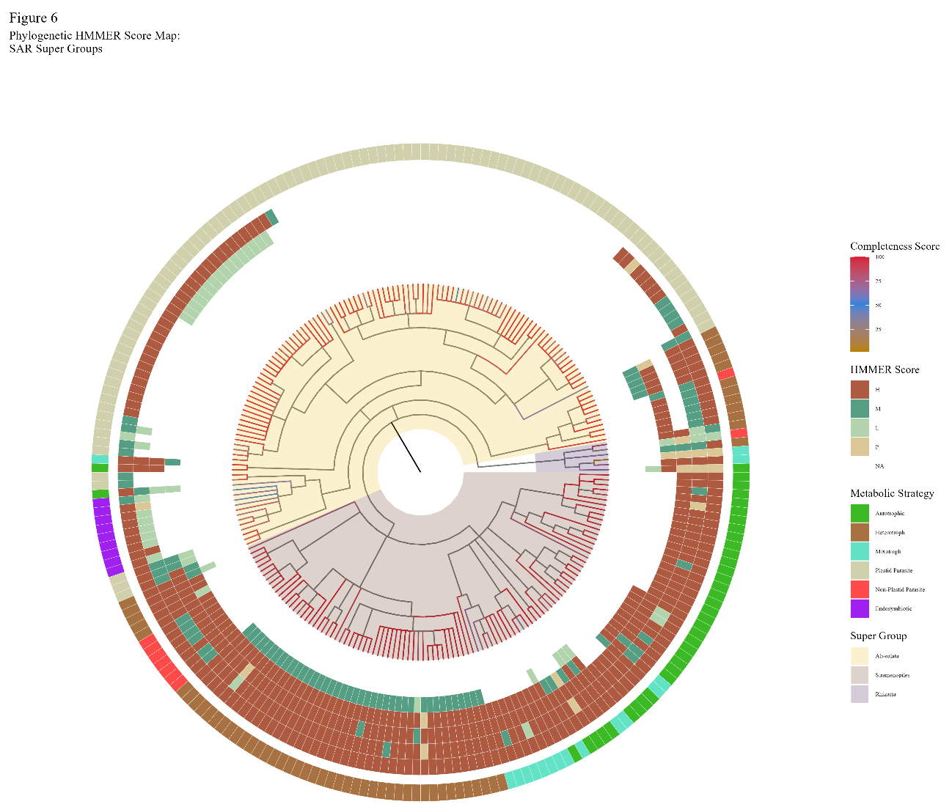

Slide 27

Figure 1
Metamonada
Opisthokonta
Amoebozoa
Discoba
Rhizaria
Streptophyta
Alveolata
Stramenopila
Rhodophyta
Chlorophyta

Slide 28

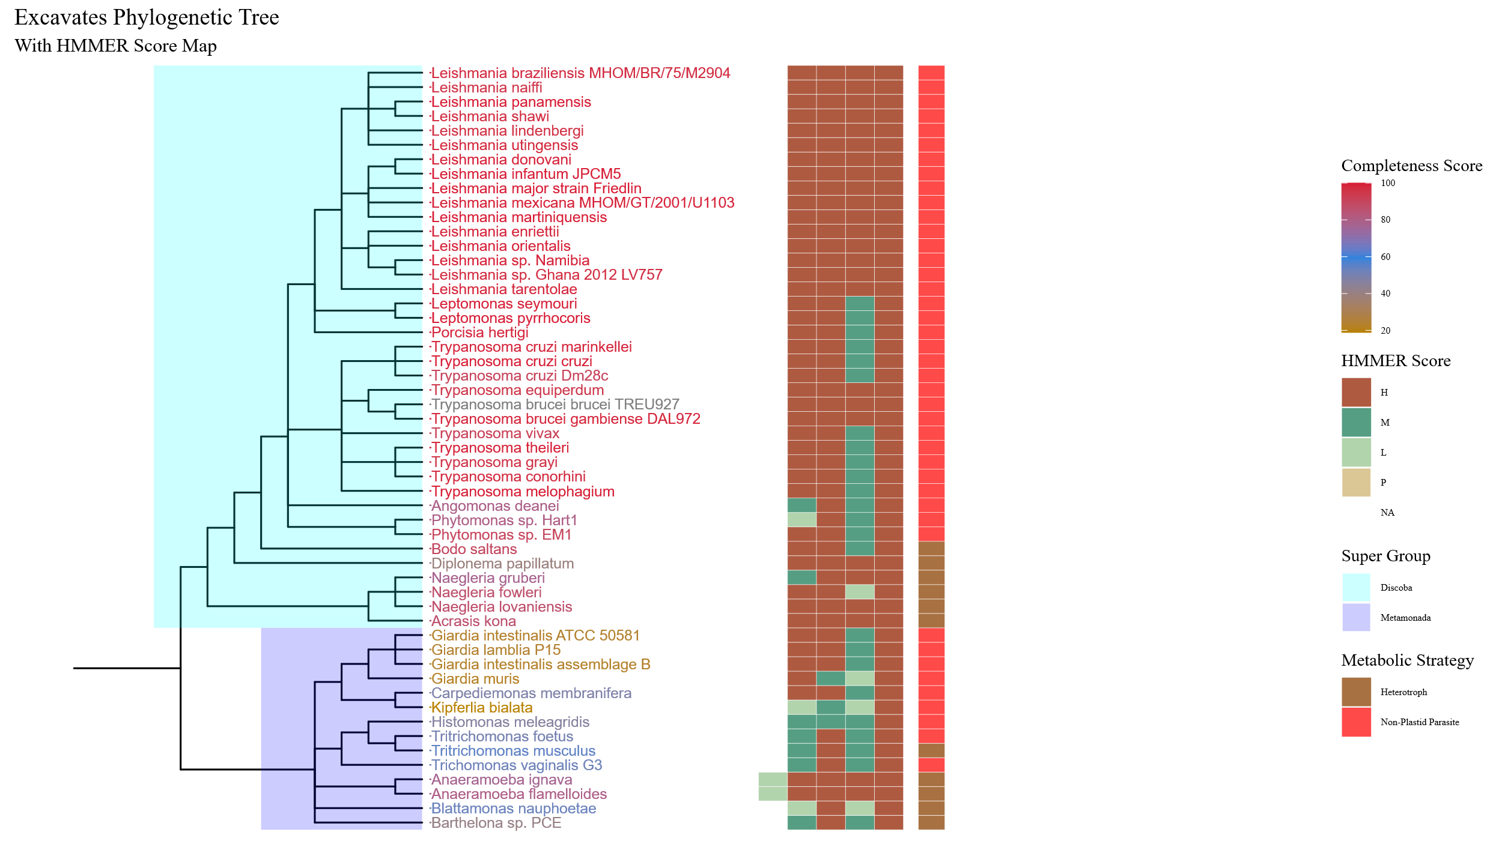
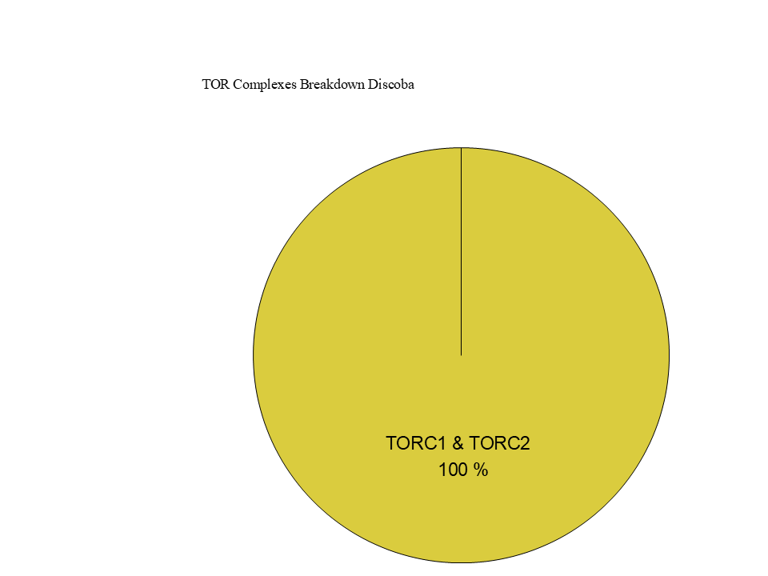
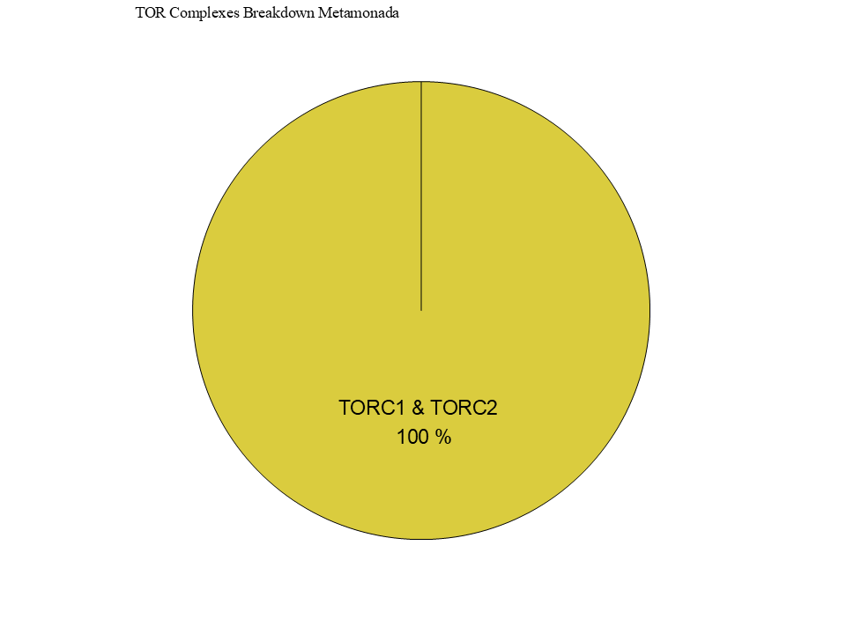
Figure 7

Slide 29
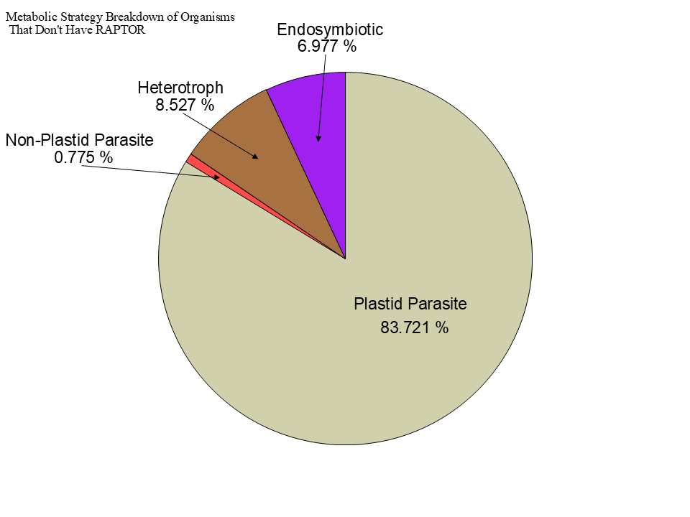
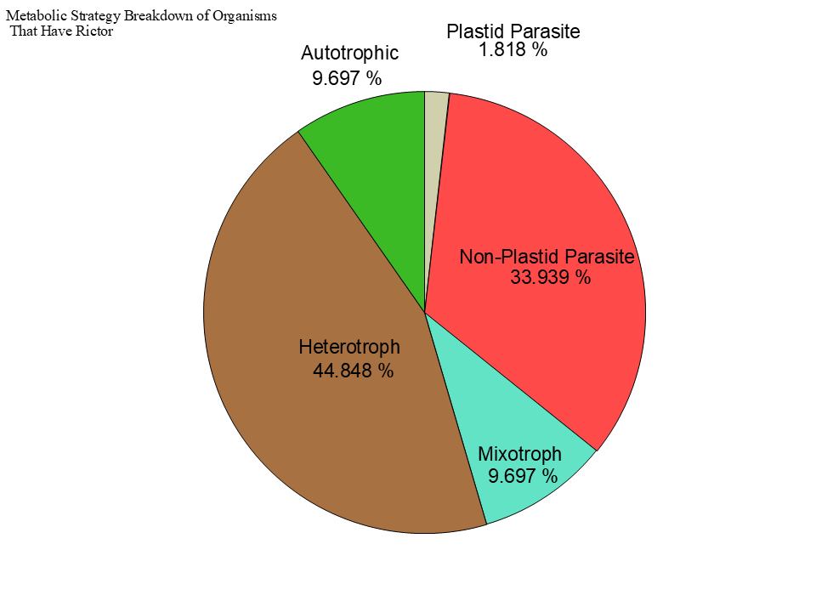
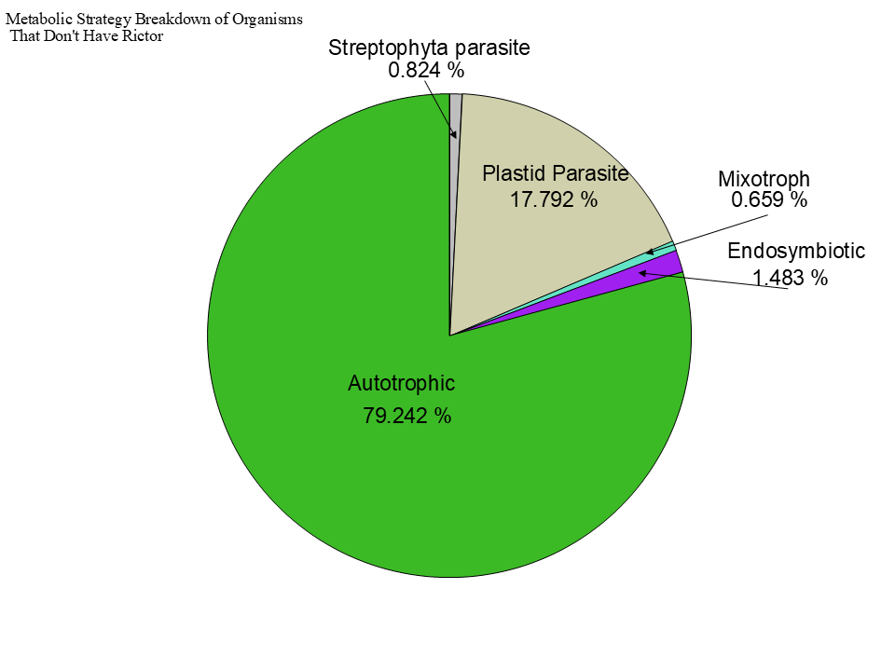

Slide 30
Figure 3

Slide 31
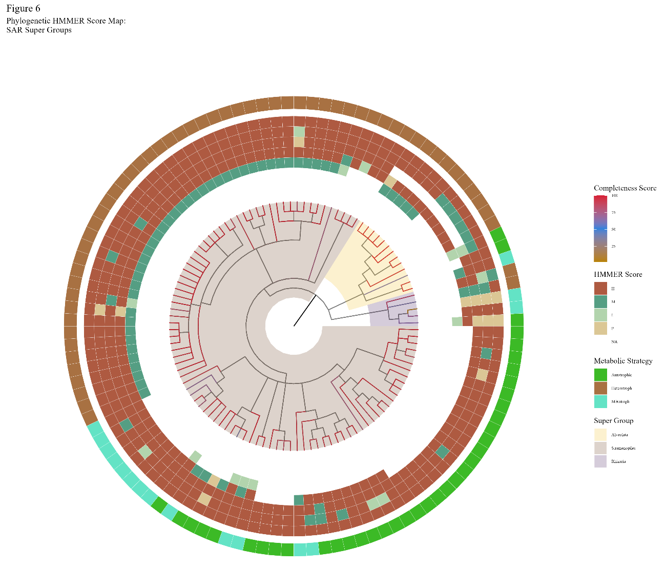



Slide 32


Slide 33


Slide 34


Slide 35

Figure 3
TOR
LST8
RAPTOR
RICTOR
SIN1

Slide 36








Figure 2

Slide 37
Metabolic Strategy
LST8
RICTOR
RAPTOR
SIN1
TOR
Stramenopiles
Alveolata
Rhizaria

